Slide 1

Policy Actions to Prevent Cancer – Webinar Series
Policy actions to improve HPV immunization rates
Dr. Jacob Shelley - Director, Health Ethics, Law and Policy (HELP) Lab, Western University
Fayad El Sheikh - Analyst, Person-Centred Perspective and Prevention, Canadian Partnership Against Cancer
Ben Rempel - Analyst, Person-Centred Perspective and Prevention, Canadian Partnership Against Cancer
08 June 2021

Slide 2

Webinar Recording

Slide 3


Housekeeping
Turn on Subtitles
in French or English
Submit Questions
Subtitles and translation is available during the webinar
Please use the Q&A function to ask questions for the presenters
Recording and slides will be shared following the webinar
Part 2 – Policy Actions to Reduce Alcohol Related Harms
  Tuesday, June 22, 2:00 pm to 3:00 pm EST
Bottom of the Screen
Top of the Screen

Slide 4

Land Acknowledgement

Slide 5
Webinar Outline
HPV immunization and cervical cancer elimination
Status of publicly-funded HPV immunization programs
Overview of immunization legislation
Opportunities to improve immunization rates
Followed by Q & A

Slide 6

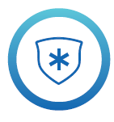
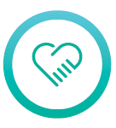


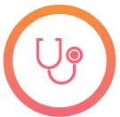
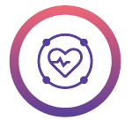


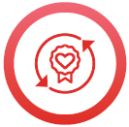


Canadian Partnership Against Cancer
2019-2029 Canadian Strategy for Cancer Control
ENABLER OUTCOMES
RESEARCH
PRIORITY OUTCOMES
PRIORITY 1
Decrease the risk of people getting cancer
PRIORITY 4
PRIORITY 6
Culturally appropriate care closer to home
Eliminate barriers to people getting the care they need
DATA
PRIORITY 2
PRIORITY 5
Deliver supports for patients, families and caregivers
PRIORITY 7
Peoples-specific, self-determined cancer care
INNOVATION
Diagnose cancer faster, accurately and at an earlier stage
PRIORITY 3
PRIORITY 8
INFORMATION
FLOW
Deliver high-quality care in a sustainable, world class system
First Nations, Inuit and/or Métis-governed research and data systems
2019-2020 Canadian Strategy for Cancer Control

Slide 7

Cervical Cancer in Canada
1,300+ people/year are diagnosed with cervical cancer in Canada.
400+ die from the disease.
Cervical cancer is almost entirely preventable and highly curable when found and treated early.
Eliminating cervical cancer in Canada is possible.
We can work together to close remaining gaps in uptake of HPV vaccination, cervical screening and appropriate follow-up.

Slide 8
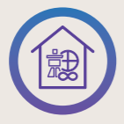
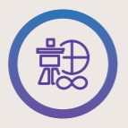
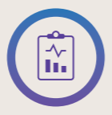
Elimination of Cervical Cancer in Canada
Action Plan Priorities and Targets
Culturally appropriate care closer to home
Peoples-specific, self-determined cancer care
Indigenous-governed research and data systems
PEOPLES-SPECIFIC PRIORITIES
Improve HPV immunization rates
Implement HPV primary screening
Improve follow-up of abnormal screening results
BY 2025
90% of 17-year-olds are fully vaccinated with the HPV vaccine
BY 2030
90% of eligible individuals are screened with an HPV test & are up-to-date with cervical screening
No less than 80% of eligible individuals in any identifiable group are up to date with cervical screening
BY 2030
90% of individuals with abnormal results receive follow-up within 3 months and those at elevated risk receive colposcopy in timely manner
No less than 90% of eligible individuals in any identifiable group receive follow-up
Canadian Partnership Against Cancer. Action plan for the elimination of cervical cancer in Canada, 2020–2030

Slide 9






HPV Immunization for the Prevention of Cervical Cancer Report
Key Statistics
HPV Immunization Policy and Program Scan
Opportunities to Increase Immunization Uptake
Policies and Programs for Underserved Populations
Public Perceptions of HPV Immunization
HPV Immunization Legislation Overview
www.partnershipagainstcancer.ca/topics/hpv-immunization-policies/

Slide 10
Status of Publicly-Funded HPV Immunization Programs in Canada
School-based Immunization Programs
  HPV Immunization is offered to both females and males in all jurisdictions
  Typically, administered between Grades 4-7 in 2-dose schedule
  All jurisdictions exclusively use the 9-valent vaccine with the exception of Quebec where a bivalent vaccine is used for the second dose
Catch-up Immunization Programs
  HPV vaccination is recommended by the National Advisory Committee on Immunization (NACI) for all individuals between ages 9 and 26
  Established programs in all jurisdictions for those who have missed school-based immunization
  Eligibility in each jurisdiction varies by age and sex
  Four provinces (BC, MB, ON, QC) have extended eligibility criteria for high-risk groups

Slide 11
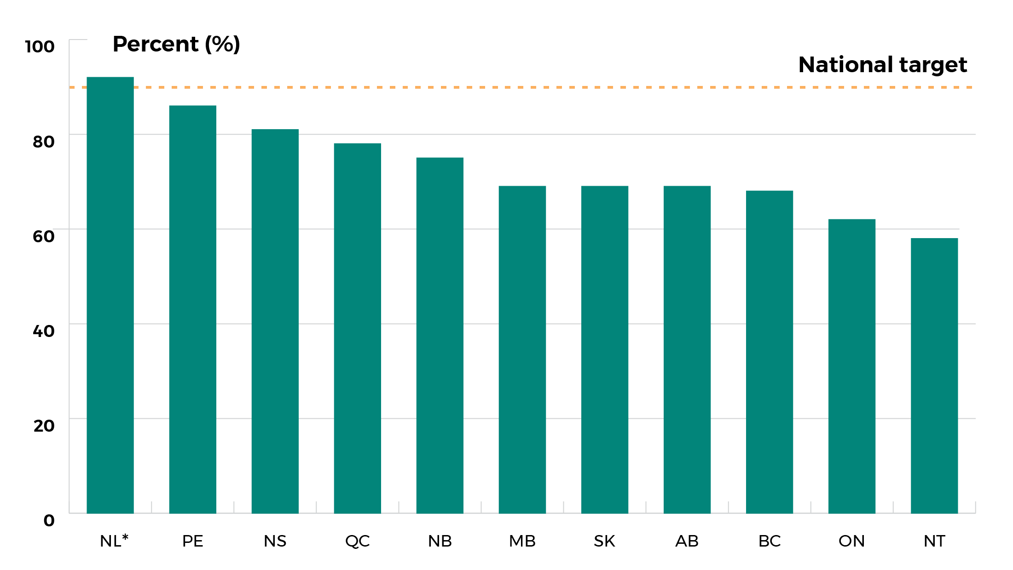
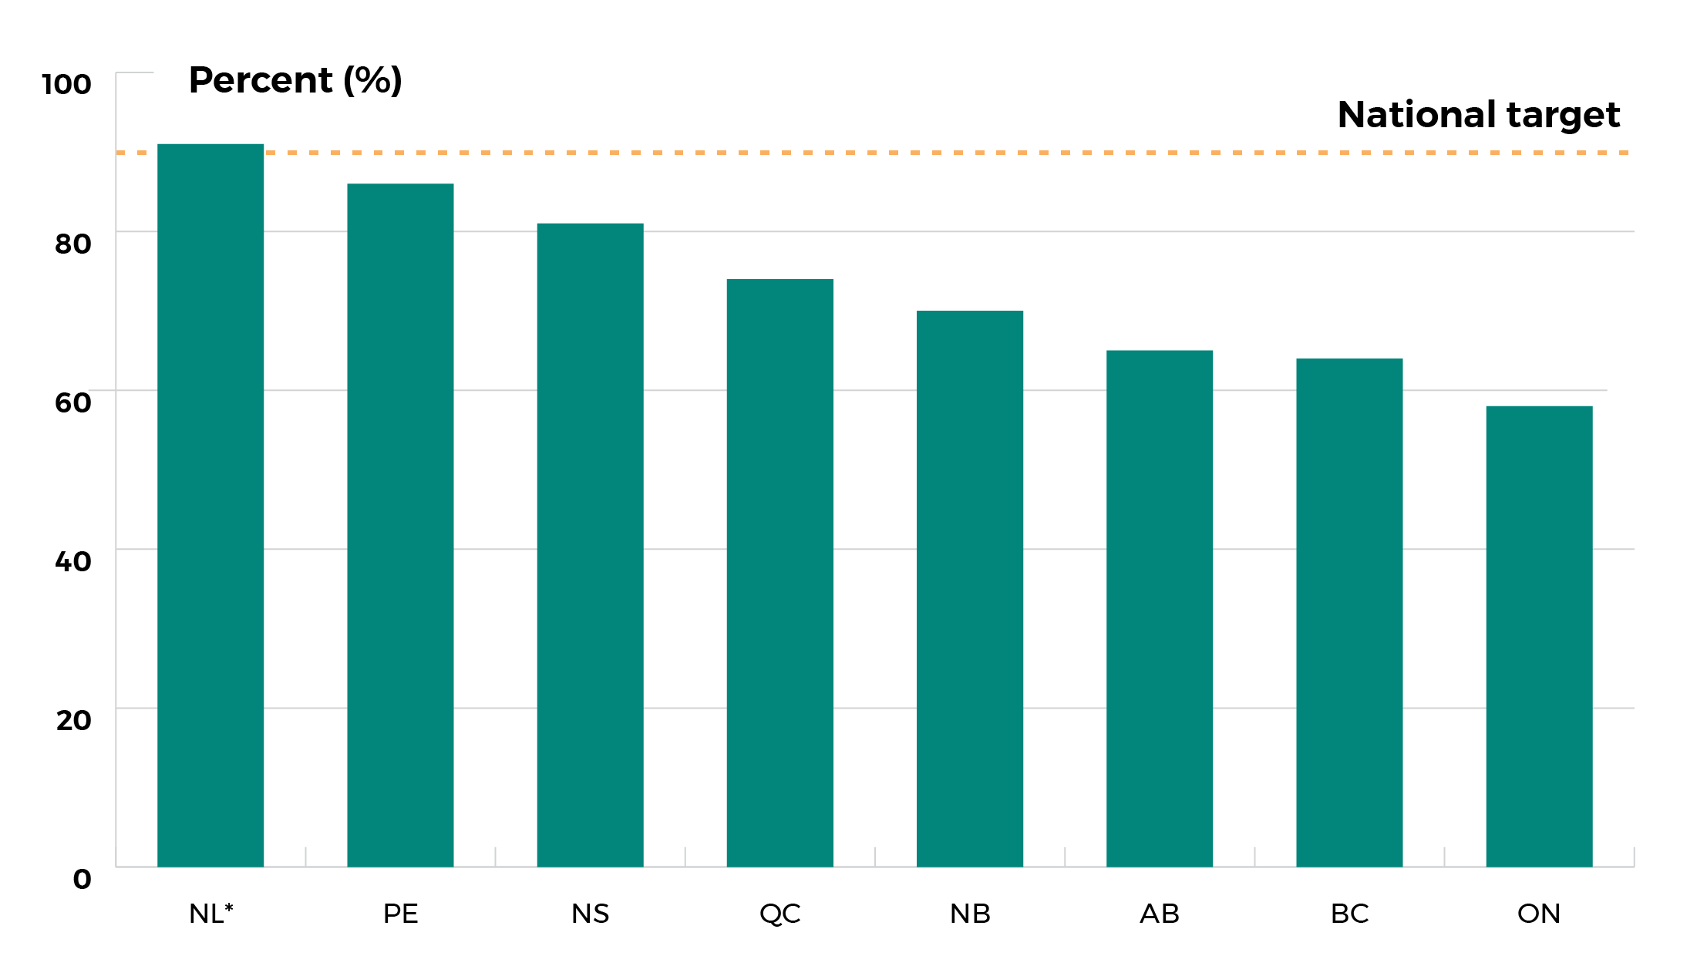
Provincial and territorial final dose uptake rates for HPV immunization (School-based)
Female
Male
*Rate for males and females
Most recent data available by jurisdiction (2015-2018)
Canadian Partnership Against Cancer. Cervical cancer screening in Canada: environmental scan, 2019.

Slide 12
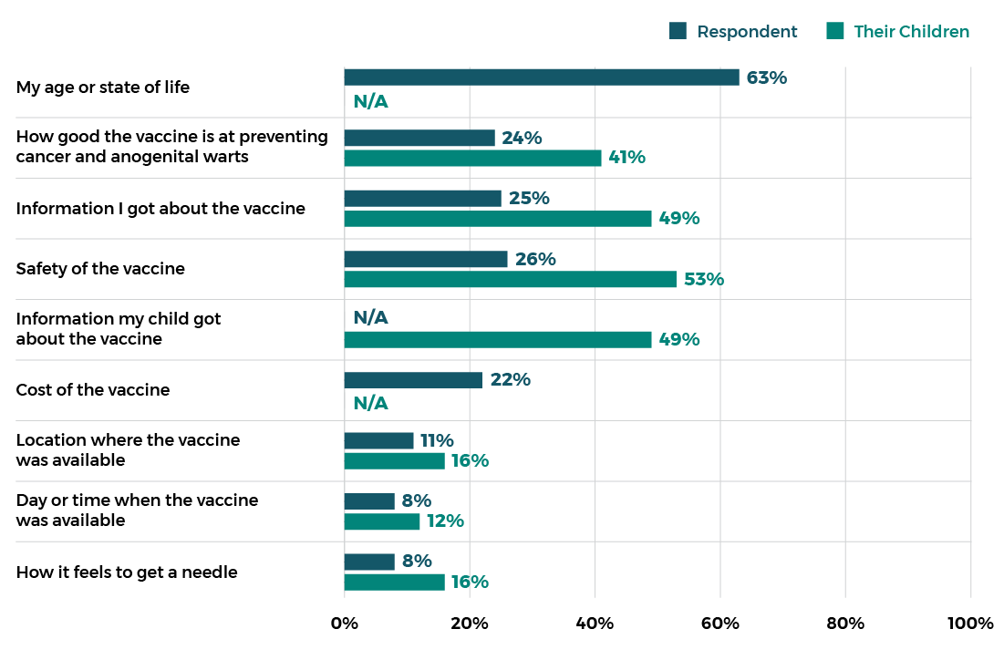
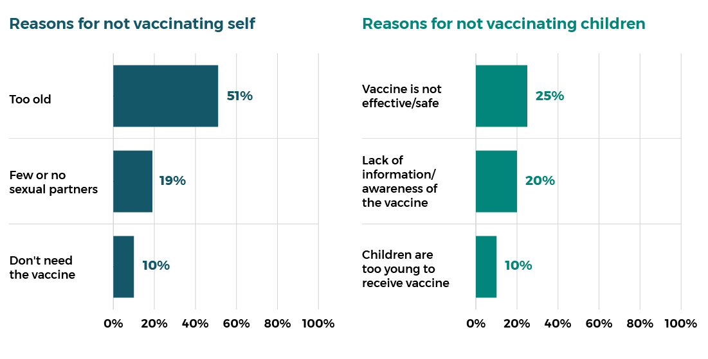
Public Perceptions
Decision factors to not receive HPV vaccination
Source:
Public and Patient Engagement to Inform Action Plan for Elimination of Cervical Cancer in Canada – Canadian Partnership Against Cancer, 2020. Unpublished Report

Slide 13
Immunization Legislation
Public health legislation and their regulations
  scheduled immunization regulations and
  reporting obligations
ii. Laws concerning consent in healthcare decision-making
iii. Mandatory immunization legislation

Slide 14
Impact of COVID-19 Pandemic
Current Opportunities
Current Challenges
Public and decision-makers more attuned to importance of prevention and public health
Investments in improving immunization data post COVID-19
Increased interest in collection of race and socioeconomic data in health
Halted school-based HPV immunization programs have due to COVID-19
Lack of access to catch-up programs
Vaccine misinformation and hesitancy
Lack of centralized registry on HPV immunization

Slide 15
Opportunities to increase HPV vaccine uptake
Affordability
To increase uptake, vaccines should be publicly funded for people living in Canada.
Accessibility
To increase uptake of HPV vaccine, it is imperative that the vaccine is available to those who did not have access to school-based programs or who did not receive the vaccination due to a lack of parent/guardian consent.
Acceptability
Strong and clear provider recommendation for vaccination.
Consideration also needs to be given to the experience of the recipient.

Slide 16
CPAC Supported Work in HPV Immunization
Focusing on identifying and reaching underimmunized, underscreened and underserved populations, including First Nations, Inuit and Métis individuals, across Canada to reach goal of elimination by 2040
  Identifying variation in HPV vaccination coverage rates, uncovering under-immunized groups
  Understanding opportunities to increase HPV immunization in school-based/youth-focused programs to better reach underimmunized
  Developing solutions or improvements to youth-focused HPV immunization programs and measurement and reporting
IMPROVE DATA + HARMONIZE > UNDERSTAND POPULATIONS PUBLIC HEALTH MUST REACH > IMPROVE IMMUNIZATION RATES

Slide 17

Q&A
Please post your questions for the presenters in the Q&A section.

Slide 18
Thank You
www.partnershipagainstcancer.ca/topics/hpv-immunization-policies/

Slide 19

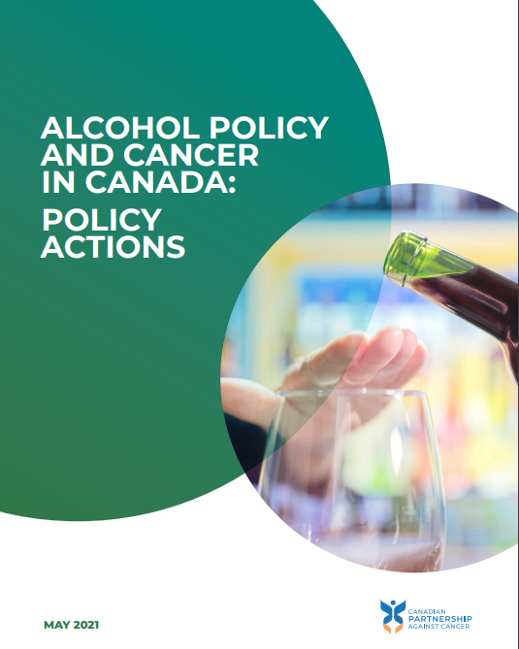
Policy actions to prevent cancer –Part 2
Tuesday June 22, 2:00 to 3:00 pm EST
Speakers
Dr. Jacob Shelley, Director, Health Ethics, Law and Policy Lab, Western University
Dr. Heather Bryant, Expert Advisor to the Partnership; Clinical Professor, University of Calgary
Benjamin Rempel, Senior Analyst, Person-Centred Perspective and Prevention, Canadian Partnership Against Cancer
www.partnershipagainstcancer.ca/topics/alcohol-policies/

