Slide 1
2014 Cancer System Performance Report
To use a hyperlink, right click on it and select ‘Open Hyperlink’, or begin a Slide Show and click on the link.
FIGURE 1.1 Percentage of population (aged ≥ 12) reporting daily or occasional smoking, by province/territory – 2012 reporting year
FIGURE 1.2 Percentage of population (aged ≥ 12), by smoking behaviour, by sex, Canada – 2012 reporting year
FIGURE 1.3 Percentage of recent smokers (aged ≥ 20) who reported quitting smoking in the last two years, by province/territory – 2012 reporting year
FIGURE 1.4 Percentage of recent smokers (aged ≥ 20) who reported quitting smoking in the last two years, by age group and sex, Canada – 2012 reporting year
FIGURE 1.5 Percentage of non-smokers (aged ≥ 12) reporting second-hand smoke exposure by setting, by province/territory – 2012 reporting year
FIGURE 1.6 Percentage of non-smokers (aged ≥ 12) reporting second-hand smoke exposure by setting, Canada – from 2003 to 2012 reporting years
FIGURE 1.7 Percentage of non-smokers (aged ≥ 12) reporting second-hand smoke exposure by setting, by age group, Canada – 2012 reporting year
FIGURE 1.8 Percentage of adults (aged ≥ 18) reporting drinking no alcohol in the last 12 months, by province/territory – 2012 reporting year
FIGURE 1.9 Percentage of adults (aged ≥ 18) reporting exceeding the low-risk drinking guideline† in the last 12 months, by province/territory – 2012 reporting year
FIGURE 1.10 Percentage of adults (aged ≥ 18) classified as overweight or obese, by province/territory – 2012 reporting year
FIGURE 1.11 Percentage of adults (aged ≥ 18) classified as overweight or obese, by sex, Canada – from 2003 to 2012 reporting years
TABLE 1.1 Implementation and immunization coverage of organized human papillomavirus vaccination programs, by province/territory
FIGURE 2.1 Percentage† of women (aged 18 to 69) reporting at least one Pap test in the last three years, by province/territory – 2008 and 2012 reporting years
FIGURE 2.2 Percentage of eligible† women (aged 50 to 69) reporting a screening†† mammogram in the last two years, by province/territory – 2008 and 2012 reporting years
FIGURE 2.3 Percentage of population (aged 50 to 74) reporting a screening† fecal test in the last two years and/or screening† sigmoidoscopy/colonoscopy in the last five years, by province/territory – 2008 and 2012 reporting years
FIGURE 2.4 Percentage of population (aged 50 to 74) reporting a screening† fecal test in the last two years and/or screening† sigmoidoscopy/ colonoscopy in the last five years, by age group and sex, Canada – 2012 reporting year
FIGURE 2.5 Percentage of population (aged 50 to 74) reporting screening† sigmoidoscopy/ colonoscopy in the last five years, by province/territory – 2008 and 2012 reporting years
FIGURE 2.6 Percentage of population (aged 50 to 74) reporting a screening† fecal test in the last two years, by province/territory – 2008 and 2012 reporting years
FIGURE 3.i Number of endoscopy units participating in the Canadian Global Rating Scale, by province – 2014
FIGURE 3.1 Median and 90th percentile wait times for resolution of abnormal breast screen without tissue biopsy for women (aged 50 to 69), by province/territory – 2011
FIGURE 3.2 Median and 90th percentile wait times for resolution of abnormal breast screen through tissue biopsy for women (aged 50 to 69), by province/territory – 2011
FIGURE 3.3 Median wait time for resolution of abnormal breast screen without tissue biopsy for women (aged 50 to 69), by province/territory – from 2004 to 2011
FIGURE 3.4 Median wait time for resolution of abnormal breast screen through tissue biopsy for women (aged 50 to 69), by province/territory – from 2004 to 2011
FIGURE 3.5 Median and 90th percentile wait times from abnormal fecal test to follow-up colonoscopy, by province – first-round screening tests conducted between Jan. 1, 2009 and Dec. 31, 2011
FIGURE 3.6 Percentage of incident cases for which stage data are available in provincial registries, four most common cancers and all cancers, by province – 2011 diagnosis year
TABLE 3.1 Percentage of cases for which stage is unknown, by disease site and province – in 2010 and 2011
FIGURE 3.7 Distribution of cases by stage at diagnosis for breast cancer (women only) – in 2010 and 2011 combined
FIGURE 3.8 Distribution of cases by stage at diagnosis for colorectal cancer – in 2010 and 2011 combined
FIGURE 3.9 Distribution of cases by stage at diagnosis for lung cancer – in 2010 and 2011 combined
FIGURE 3.10 Distribution of cases by stage at diagnosis for prostate cancer – in 2010 and 2011 combined

Slide 2
FIGURE 4.1 Percentage of colon resections with 12 or more lymph nodes removed and examined, by province – patients diagnosed from 2007 to 2010
FIGURE 4.2 Percentage of colon resections with 12 or more lymph nodes removed and examined, by patient age group – patients diagnosed from 2007 to 2010
FIGURE 4.3 Percentage of colon resections with 12 or more lymph nodes removed and examined, by patient age group, by sex – patients diagnosed in 2010
FIGURE 4.4 Percentage of Stage II or III rectal cancer patients who had a surgical resection within one year of diagnosis, by province – patients diagnosed in 2009 and 2010
FIGURE 4.5 Percentage of Stage III colon cancer patients who had a surgical resection within one year of diagnosis, by province – patients diagnosed in 2009 and 2010
FIGURE 4.6 Percentage of Stage II or IIIA non–small cell lung cancer patients who had a surgical resection within one year of diagnosis, by province – patients diagnosed in 2009 and 2010
FIGURE 4.7 Percentage of patients with Stage II or III rectal cancer, Stage III colon cancer or Stage II or IIIA non–small cell lung cancer who had a surgical resection within one year of diagnosis, by patient age group, by sex – patients diagnosed in 2010
FIGURE 4.8 Median and 90th percentile wait times for radiation therapy, all cancers, by province – 2012 treatment year
FIGURE 4.9 90th percentile wait time for radiation therapy, by disease site, by province – 2012 treatment year
TABLE 4.1 Percentage of patients treated within the radiation therapy wait time target, four most common cancers and all cancers, by province – 2012 treatment year
FIGURE 4.10 Percentage of cancer patients receiving radiation therapy within two years of diagnosis, by province – patients diagnosed in 2010
FIGURE 4.11 Number of linear accelerators per million people, by province – 2012 reporting year
FIGURE 4.12 Percentage of Stage II or III rectal cancer patients who received radiation therapy before surgery, by province – patients diagnosed from 2007 to 2010
FIGURE 4.13 Percentage of Stage II or III rectal cancer patients who received radiation therapy before surgery, by patient age group – patients diagnosed from 2007 to 2010
FIGURE 4.14 Percentage of Stage II or III rectal cancer patients who received radiation therapy before surgery, by patient age group, by sex – patients diagnosed in 2010
FIGURE 4.15 Percentage of Stage I or II breast cancer patients receiving radiation therapy following breast conserving surgery, by province – patients diagnosed in 2009 and 2010
FIGURE 4.16 Percentage of Stage I or II breast cancer patients receiving radiation therapy following breast conserving surgery, by patient age group – patients diagnosed from 2007 to 2010
FIGURE 4.17 Percentage of Stage III colon cancer patients receiving chemotherapy following surgical resection, by province – patients diagnosed from 2007 to 2010
FIGURE 4.18 Percentage of Stage III colon cancer patients receiving chemotherapy following surgical resection, by patient age group – patients diagnosed from 2007 to 2010
FIGURE 4.19 Percentage of Stage III colon cancer patients receiving chemotherapy following surgical resection, by patient age group, by sex – patients diagnosed in 2010
FIGURE 4.20 Percentage of Stage II or IIIA non–small cell lung cancer patients who received chemotherapy following surgical resection, by province – patients diagnosed from 2007 to 2010
FIGURE 4.21 Percentage of Stage II or IIIA non–small cell lung cancer patients who received chemotherapy following surgical resection, by patient age group – patients diagnosed from 2007 to 2010
FIGURE 4.22 Percentage of Stage II or IIIA non–small cell lung cancer patients who received chemotherapy following surgical resection, by patient age group, by sex – patients diagnosed in 2010
TABLE 5.1 Level of implementation of standardized symptom assessment tools, by province – 2013
FIGURE 5.1 Edmonton Symptom Assessment System Screening Tool and the Canadian Problem Checklist
FIGURE 5.2 Percentage of patients reporting negative rating across dimensions of care and for overall quality of care, by province – from 2011 to 2013
FIGURE 5.3 Emotional support dimension: Percentage of patients reporting negative rating, by age, sex, education, health status, reason for treatment, disease site and time since diagnosis – from 2011 to 2013

Slide 3
FIGURE 5.4 Percentage of cancer patient deaths occurring in hospital or other, by province – 2009
FIGURE 5.5 Percentage of cancer patient deaths occurring in hospital, private home or other, Canada – from 2005 to 2009
FIGURE 6.1 Ratio of adult patients enrolled in clinical trials to number of incident cases, by province, all cancers – 2012 enrolment year
FIGURE 6.2 Ratio of adult patients enrolled in clinical trials to number of incident cases, by disease site, four most common cancers and all cancers – 2012 enrolment year
FIGURE 6.3 Ratio of pediatric patients enrolled in clinical trials to number of new patient registrations at children’s treatment centres, by province – patients seen in 2011 and 2012
FIGURE 6.4 Distribution of cancer research investment (2010), new cancer cases (2008) and cancer deaths (2009), by disease site, Canada
FIGURE 7.1 Screening outside of guidelines: Percentage of women (aged ≥ 75) reporting a screening† mammogram in the last two years, by province/ territory – 2012 reporting year
FIGURE 7.2 Percentage of breast cancer mastectomies done as day surgery, by province/territory – from 2007/08 to 2011/12 fiscal years combined
FIGURE 7.3 Percentage of cancer patients admitted to, and dying in, an intensive care unit in the last two weeks of life, by province – in 2011/12 and 2012/13 fiscal years combined
FIGURE 8.i Incidence rates by five-year age groups, all cancers, Canada – 2008
TABLE 8.i Three measures of cancer burden – in 1992 and 2008
FIGURE 8.ii Age structure of Canadian population – in 1991 and 2011
FIGURE 8.iii Crude and age-standardized incidence rates using 1991 and 2011 reference populations, all cancers, Canada – 2008
FIGURE 8.iv Change in percentage of population over 60 years of age – from 1991 to 2011
TABLE 8.ii Crude and age-standardized incidence rates using 1991 and 2011 reference populations, all cancers, by province – 2008
FIGURE 8.1 Age-standardized (2011 population) incidence and mortality rates for breast cancer in women, Canada – from 1992 to 2009
FIGURE 8.2 Age-standardized (2011 population) incidence rates for breast cancer in women, by province – from 2008 to 2010
FIGURE 8.3 Age-standardized (2011 population) mortality rates for breast cancer in women, by province – from 2007 to 2009
FIGURE 8.4 Age-standardized† five-year relative survival ratios for breast cancer, both sexes combined, by province – from 2006 to 2008
FIGURE 8.5 Age-standardized† five-year relative survival ratios for breast cancer, both sexes combined, Canada – 1992 to 1994 vs. 2006 to 2008
FIGURE 8.6 Age-standardized (2011 population) incidence and mortality rates for lung cancer, by sex, Canada – from 1992 to 2009
FIGURE 8.7 Age-standardized (2011 population) incidence rates for lung cancer, by sex, by province – from 2008 to 2010
FIGURE 8.8 Age-standardized (2011 population) mortality rates for lung cancer, by province – from 2007 to 2009
FIGURE 8.9 Age-standardized† five-year relative survival ratios for lung cancer, by province – from 2006 to 2008
FIGURE 8.10 Age-standardized† five-year relative survival ratios for lung cancer, Canada – 1992 to 1994 vs. 2006 to 2008
FIGURE 8.11 Age-standardized (2011 population) incidence and mortality rates for colorectal cancer, by sex, Canada – from 1992 to 2009
FIGURE 8.12 Age-standardized (2011 population) incidence rates for colorectal cancer, by sex, by province – from 2008 to 2010
FIGURE 8.13 Age-standardized (2011 population) mortality rates for colorectal cancer, by province – from 2007 to 2009
FIGURE 8.14 Age-standardized† five-year relative survival ratios for colorectal cancer, by province – from 2006 to 2008
FIGURE 8.15 Age-standardized† five-year relative survival ratios for colorectal cancer, Canada – 1992 to 1994 vs. 2006 to 2008
FIGURE 8.16 Age-standardized (2011 population) incidence and mortality rates for prostate cancer, Canada – from 1992 to 2009
FIGURE 8.17 Age-standardized (2011 population) incidence rates for prostate cancer, by province – from 2008 to 2010

Slide 4
FIGURE 8.18 Age-standardized (2011 population) mortality rates for prostate cancer, by province – from 2007 to 2009
FIGURE 8.19 Age-standardized (2011 population) incidence and mortality rates for pancreatic cancer, by sex, Canada – from 1992 to 2009
FIGURE 8.20 Age-standardized (2011 population) incidence rates for pancreatic cancer, by province – from 2008 to 2010
FIGURE 8.21 Age-standardized (2011 population) mortality rates for pancreatic cancer, by province – from 2005 to 2009
FIGURE 8.22 Age-standardized† five-year relative survival ratios for pancreatic cancer, by province – from 2005 to 2007
FIGURE 8.23 Age-standardized† five-year relative survival ratios for pancreatic cancer, Canada – 1992 to 1994 vs. 2006 to 2008

Slide 5
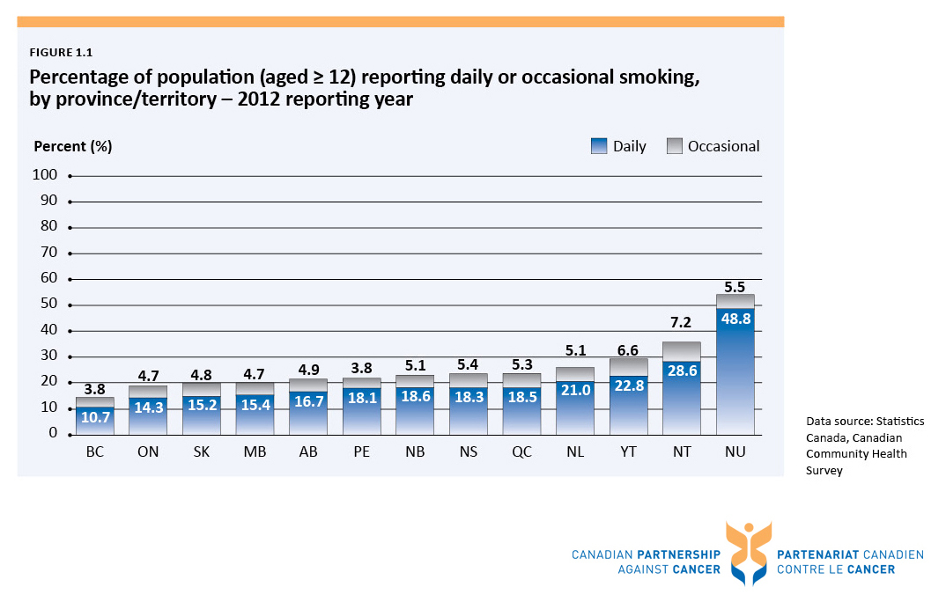

Slide 6
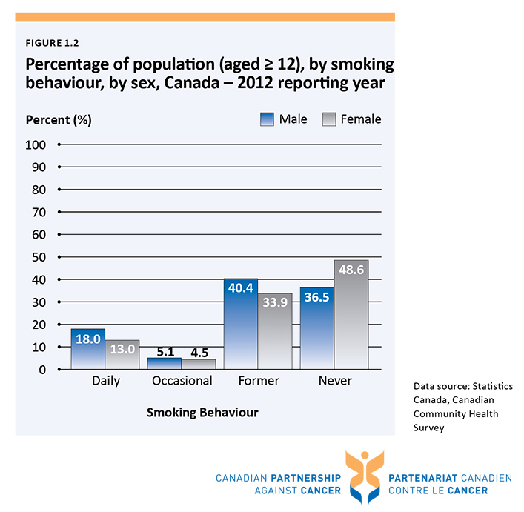

Slide 7
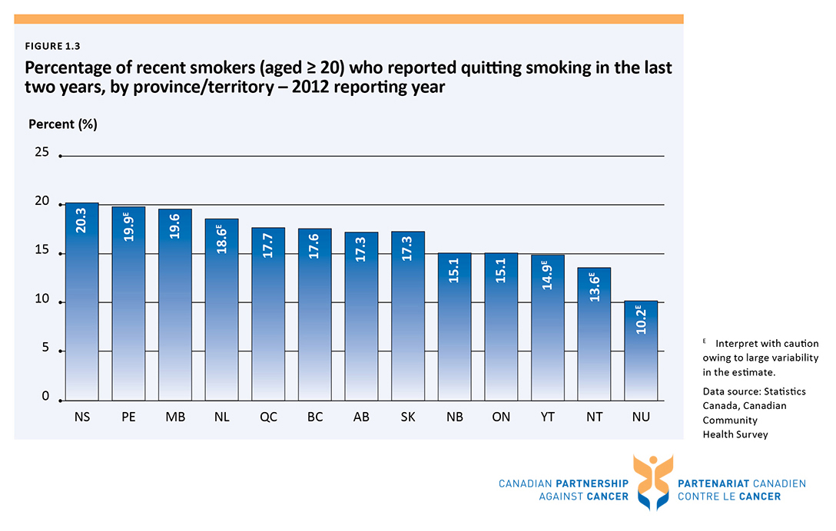

Slide 8
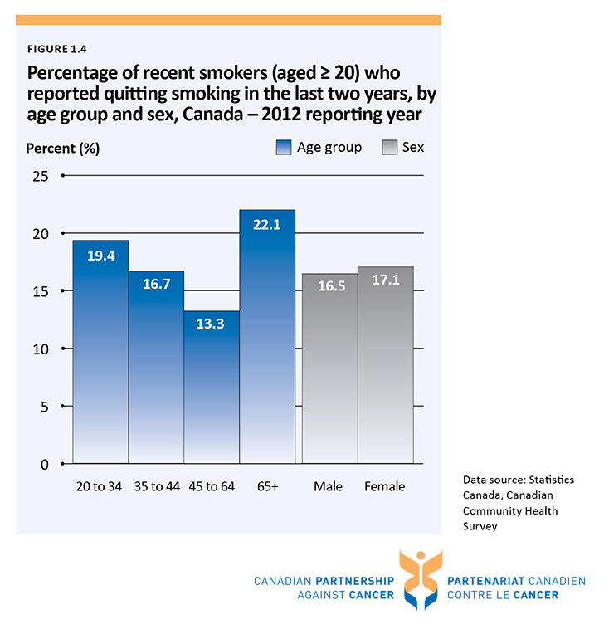

Slide 9
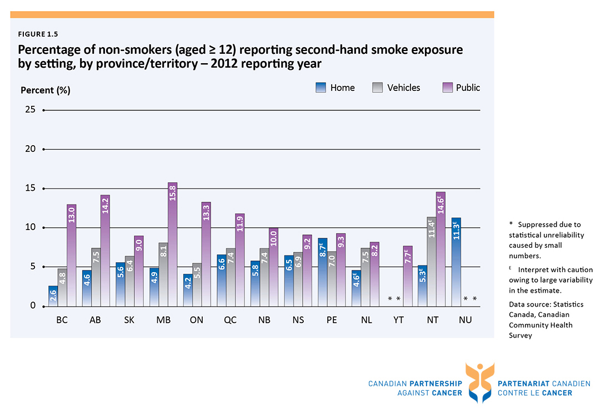

Slide 10
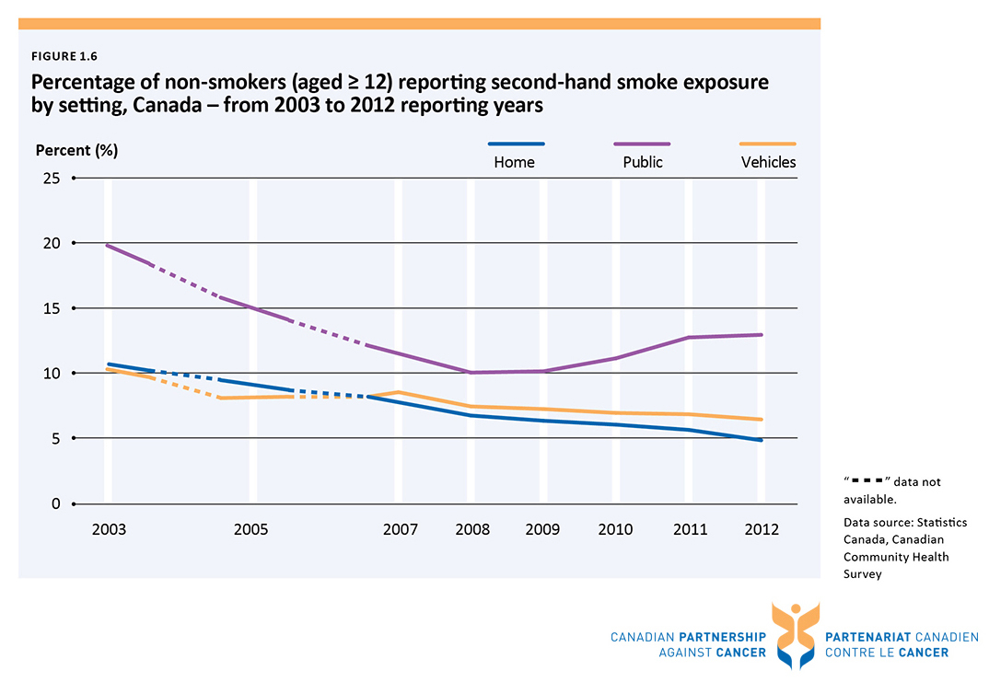

Slide 11
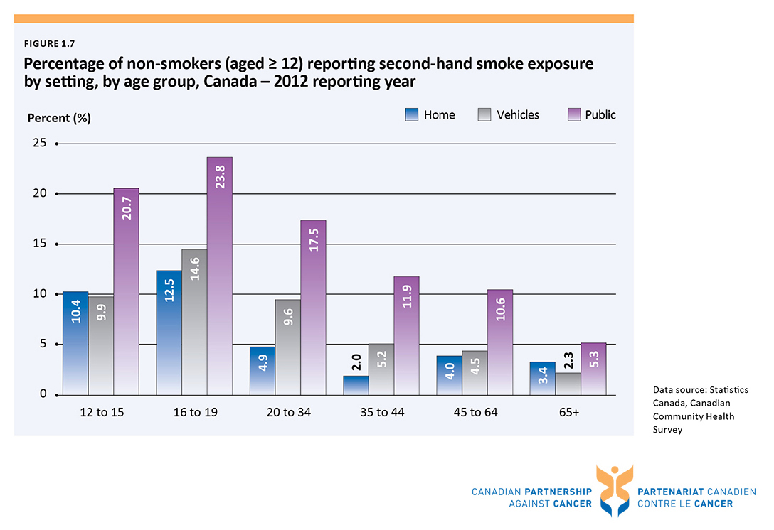

Slide 12
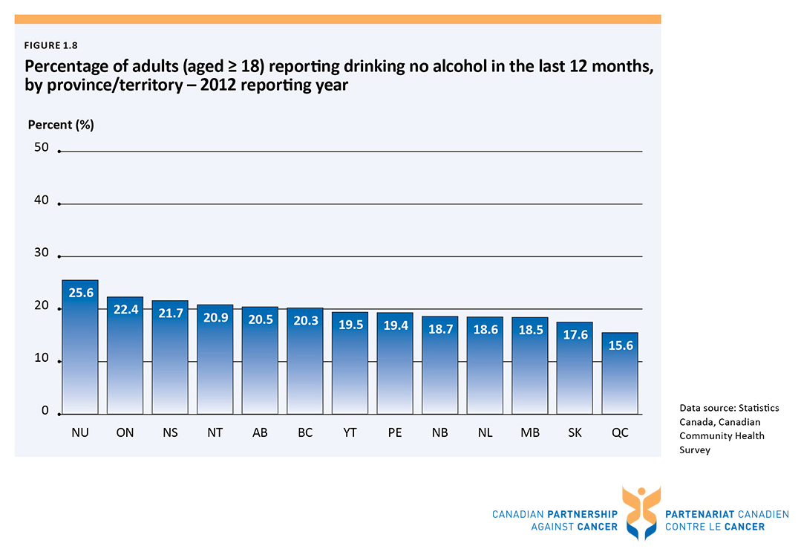

Slide 13
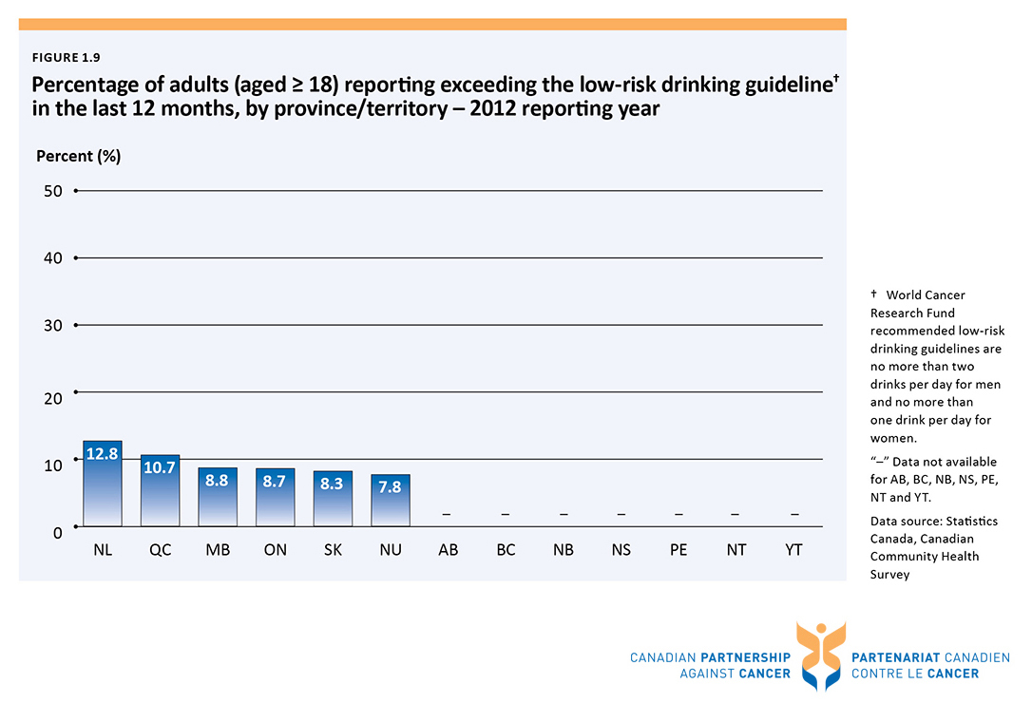

Slide 14
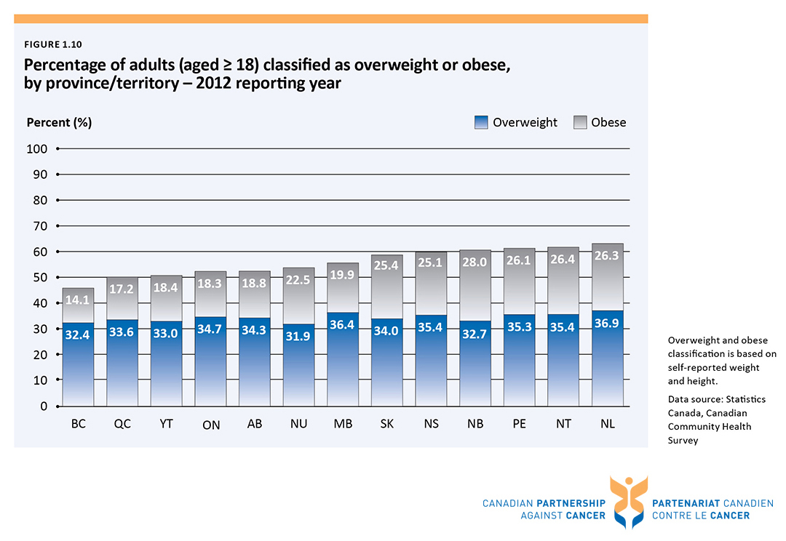

Slide 15
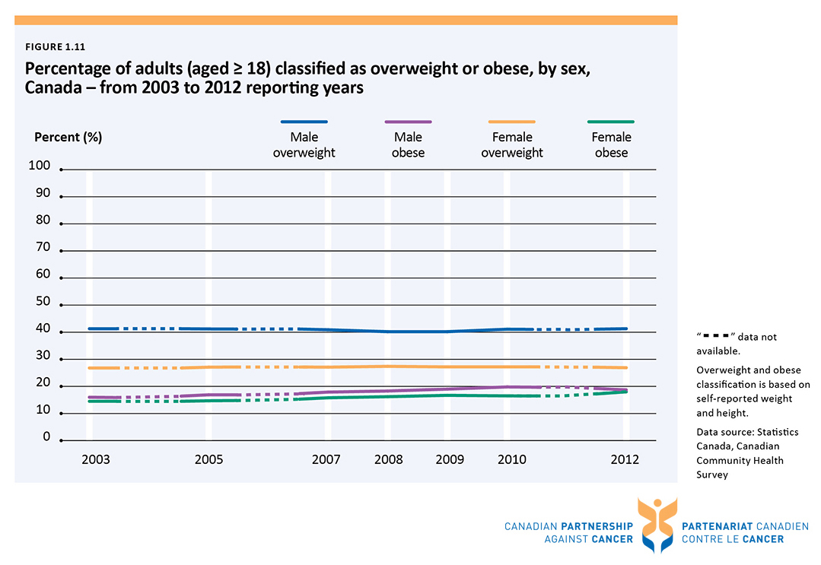

Slide 16
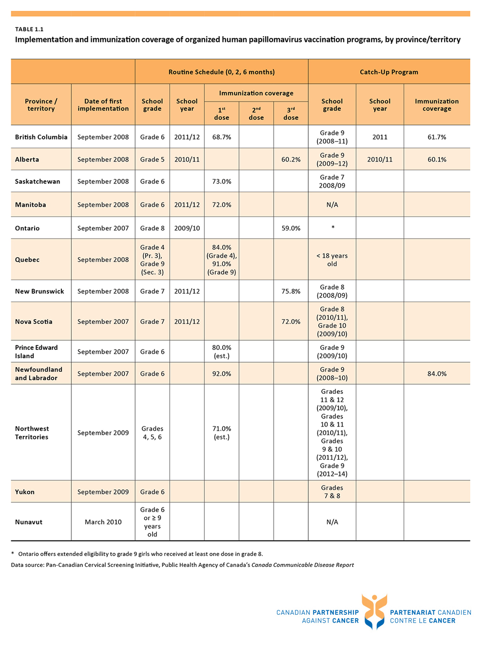

Slide 17
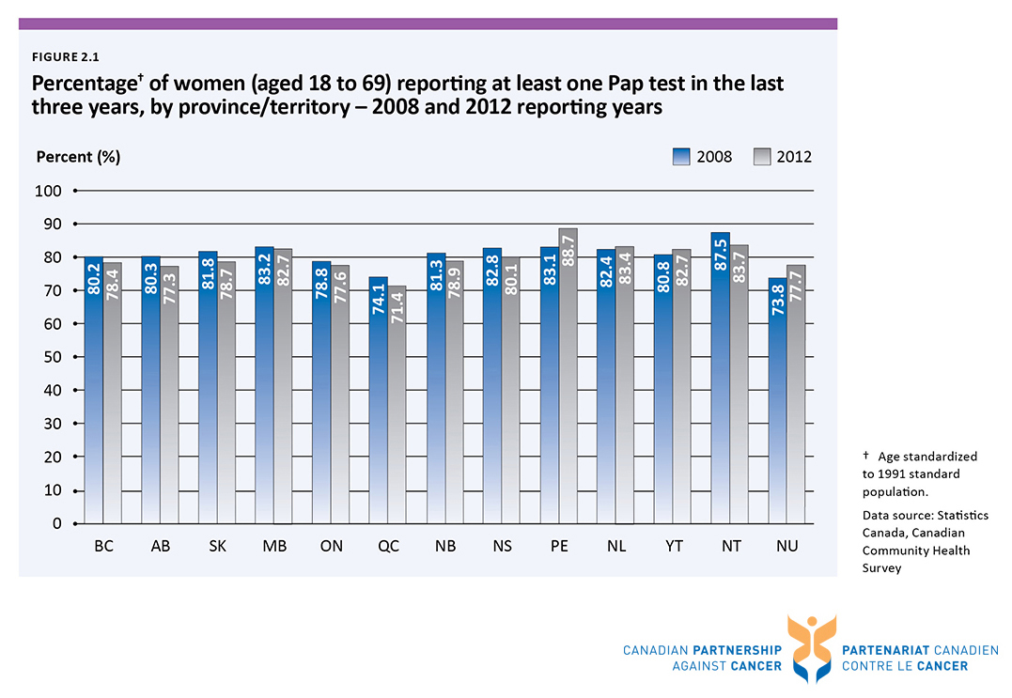

Slide 18
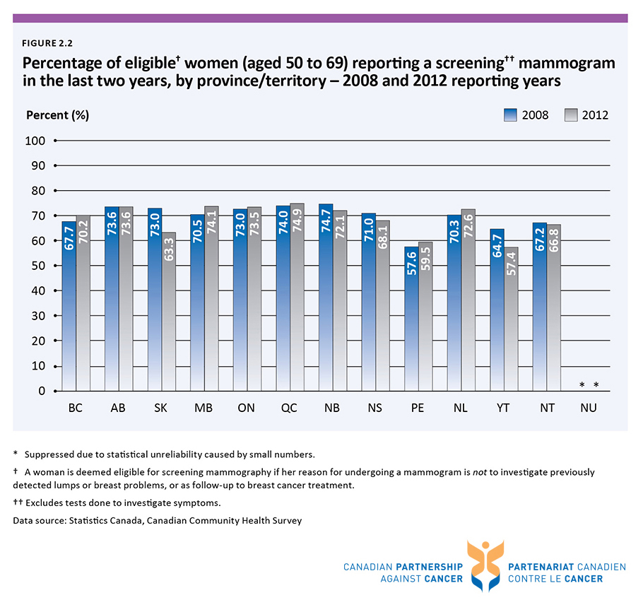

Slide 19
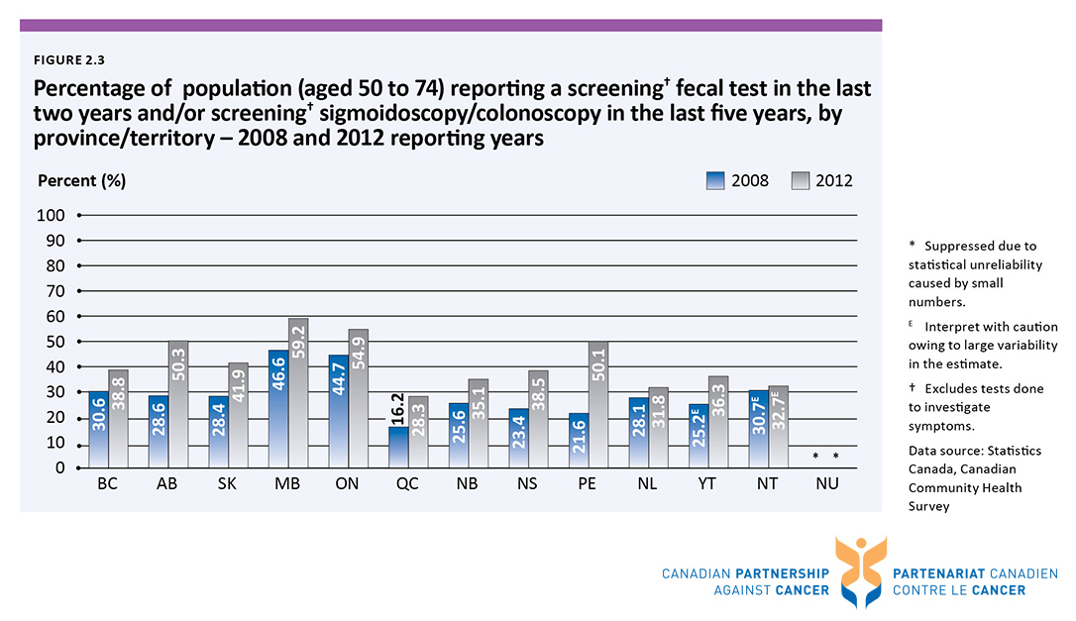

Slide 20
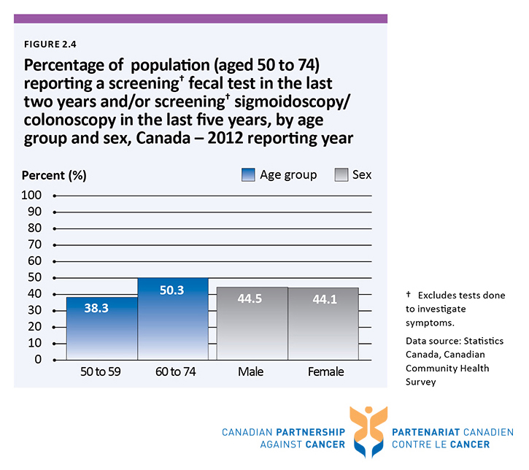

Slide 21
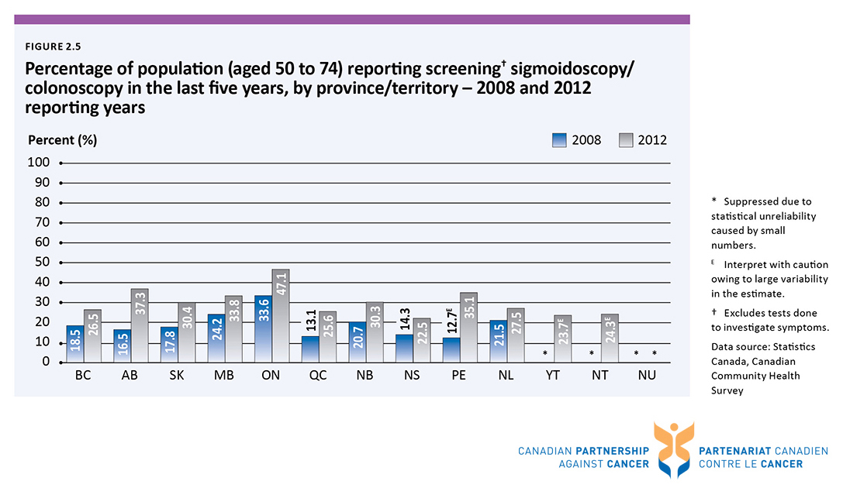

Slide 22
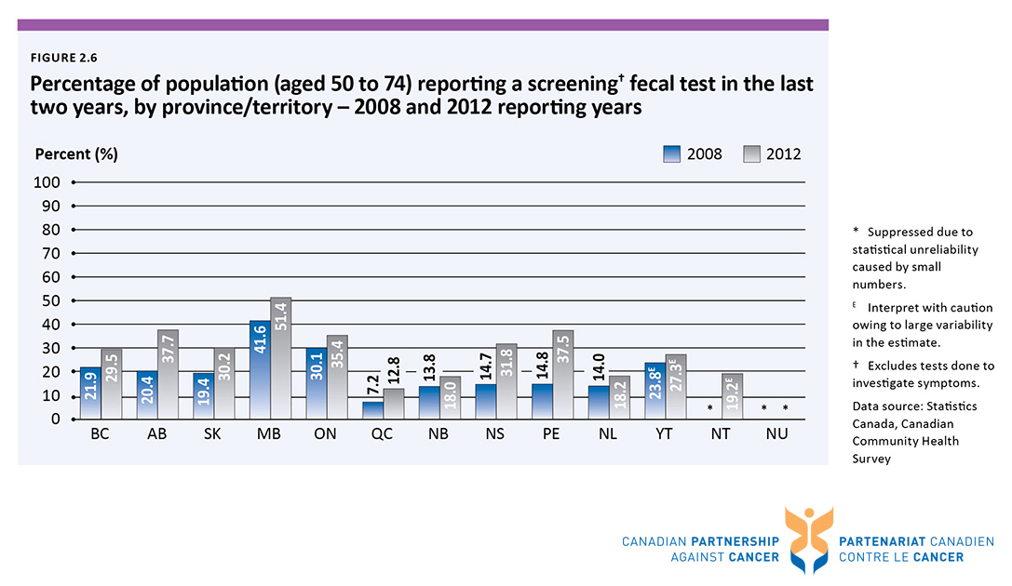

Slide 23
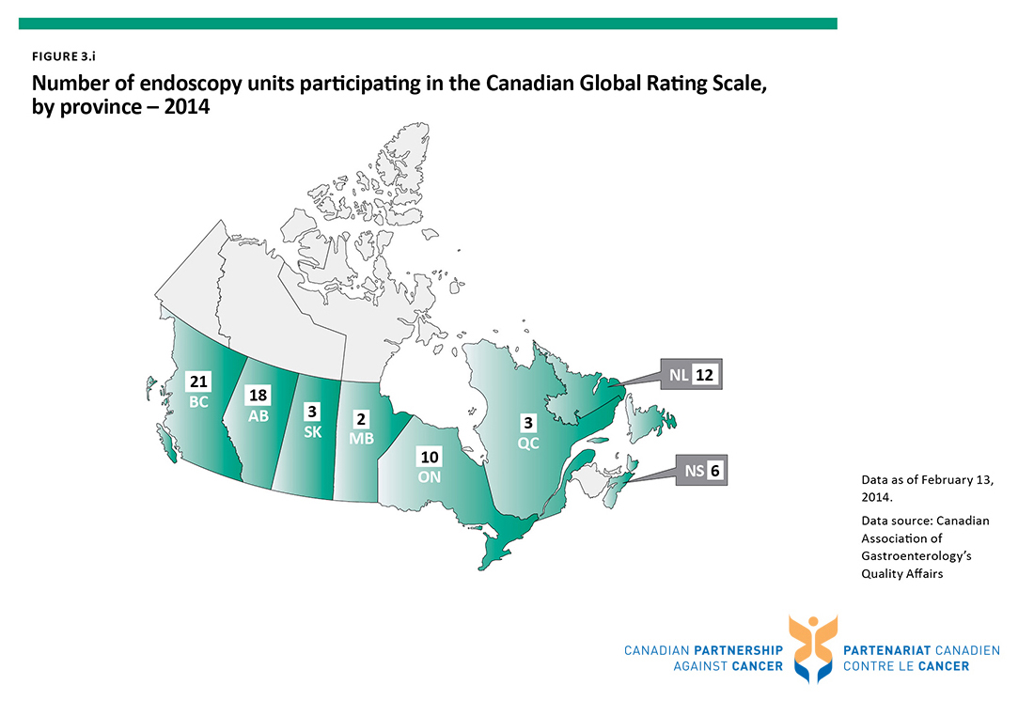

Slide 24
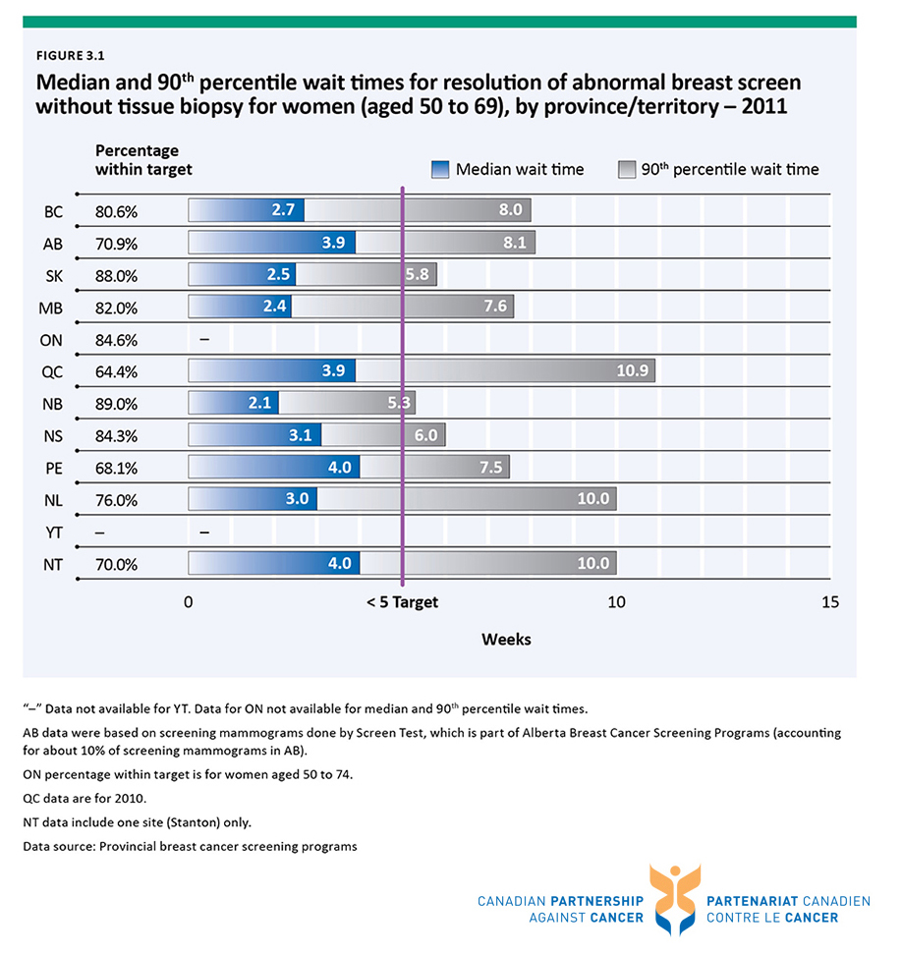

Slide 25
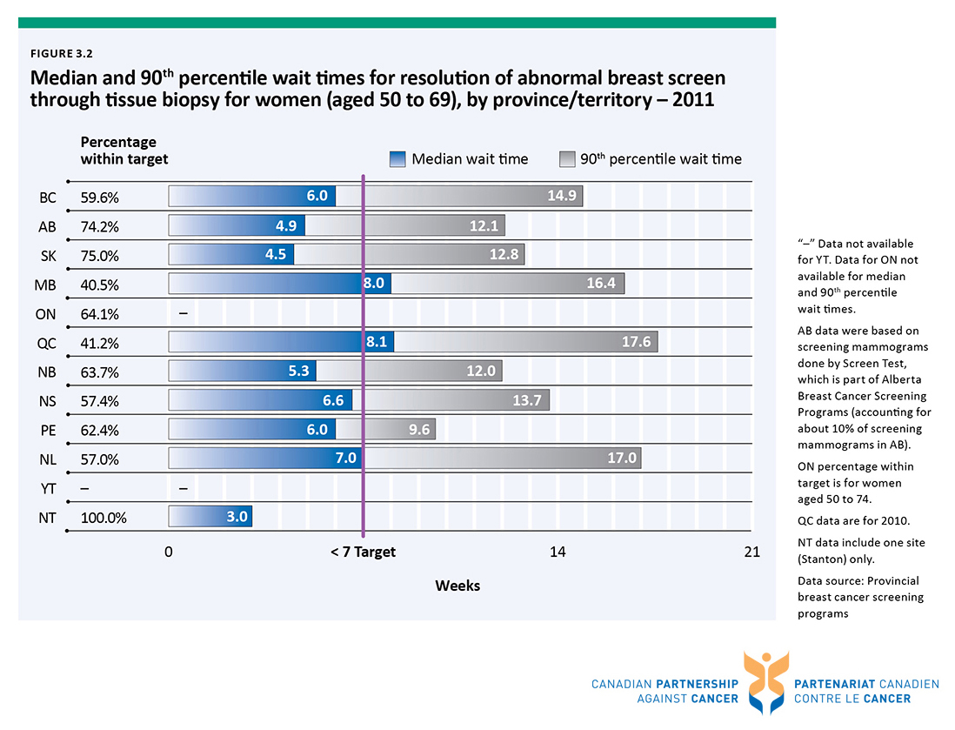

Slide 26
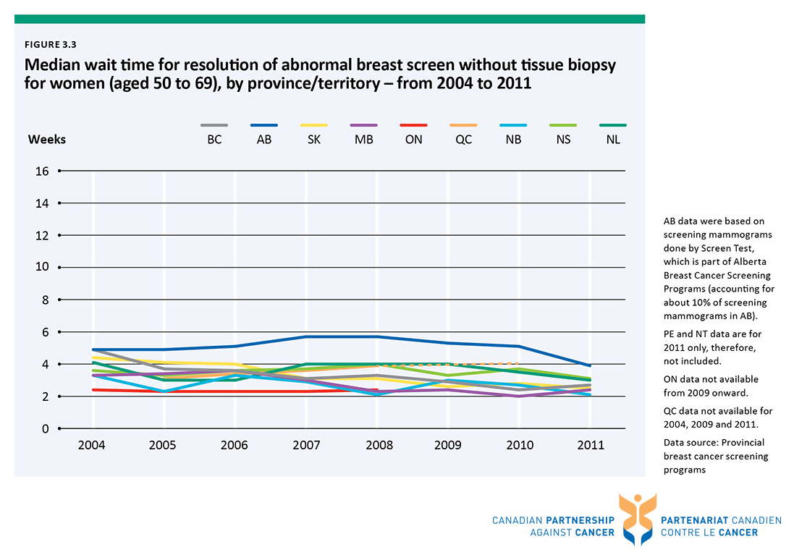

Slide 27
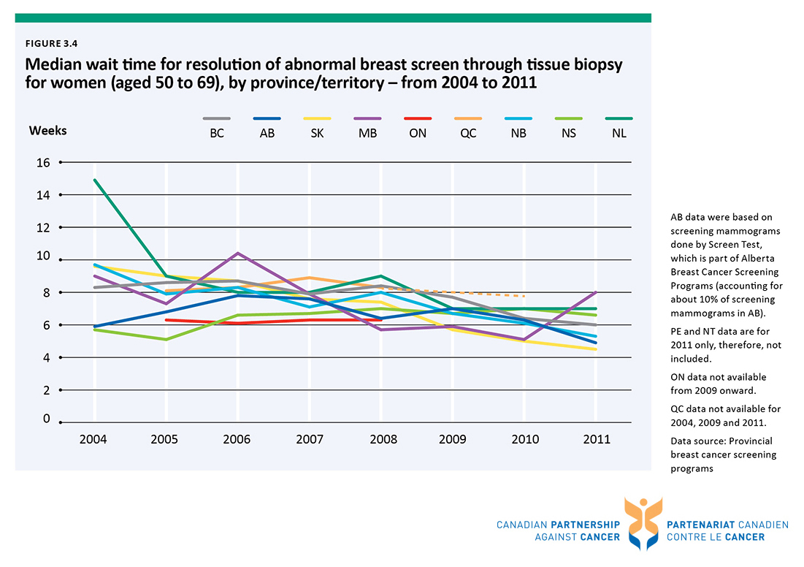

Slide 28
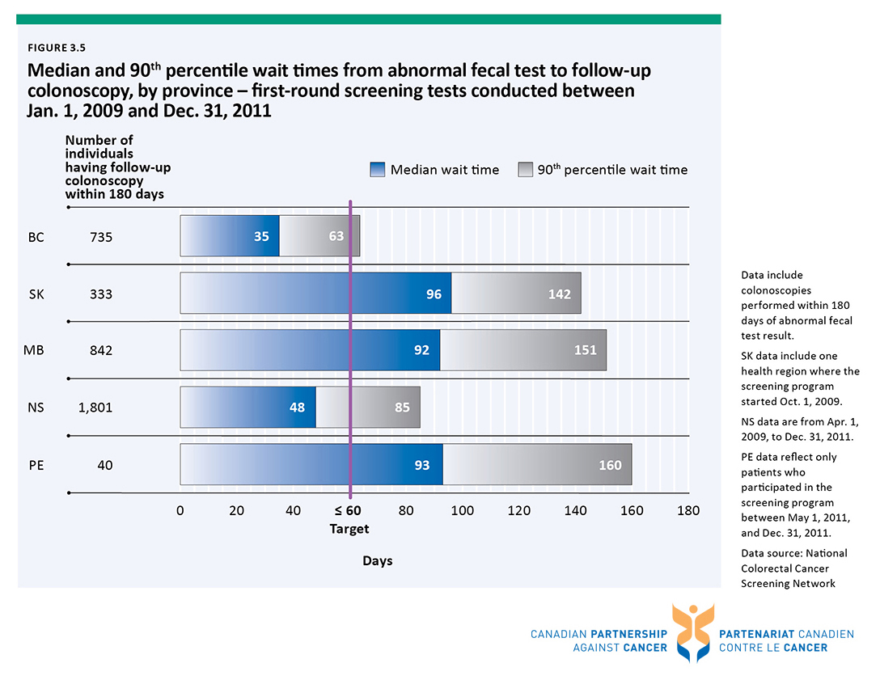

Slide 29
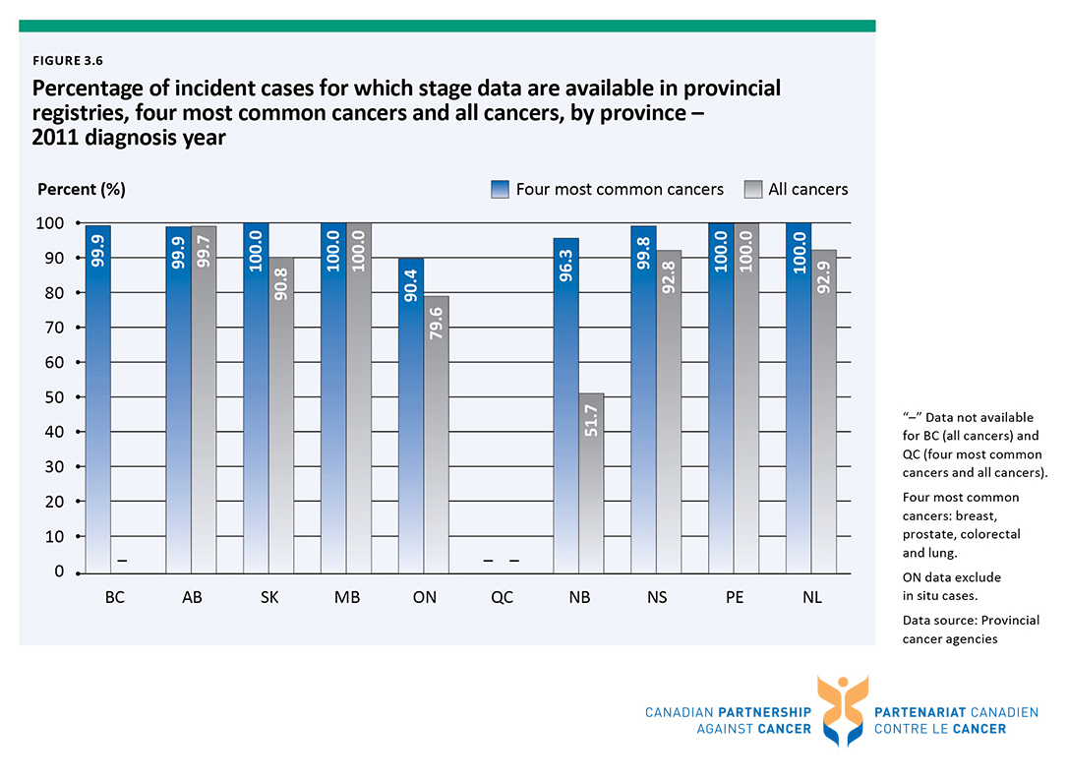

Slide 30
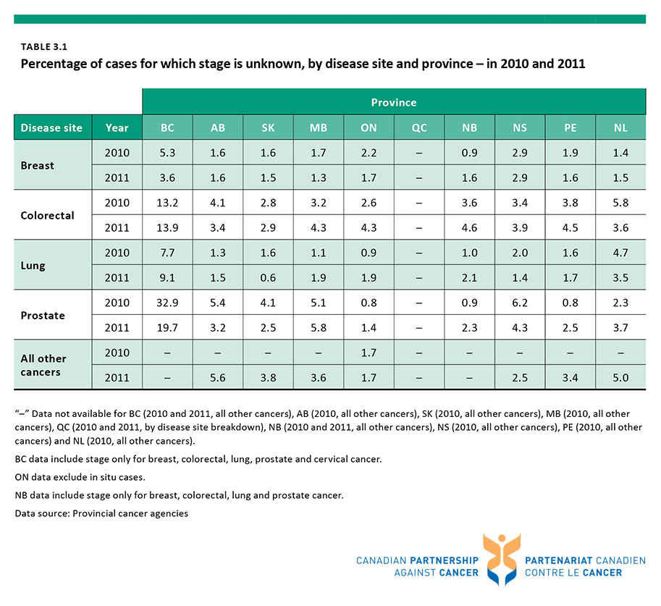

Slide 31
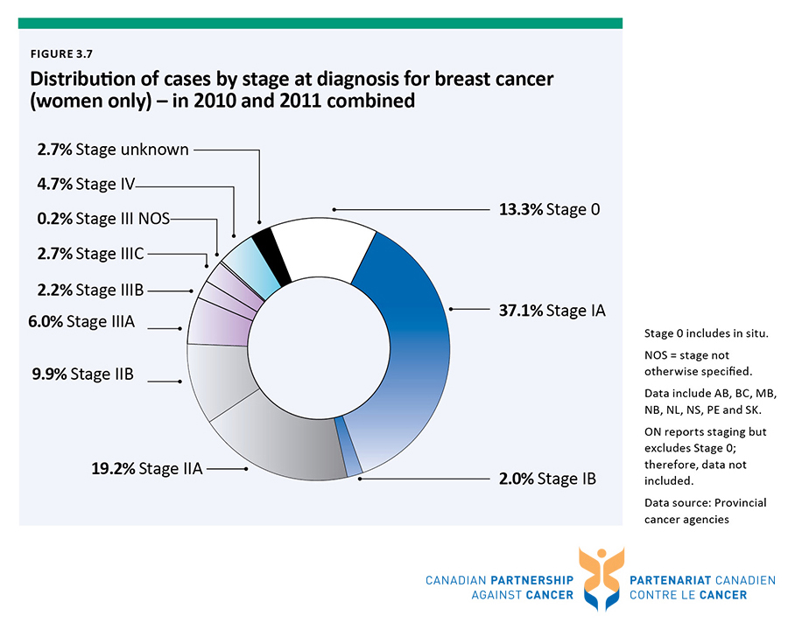

Slide 32
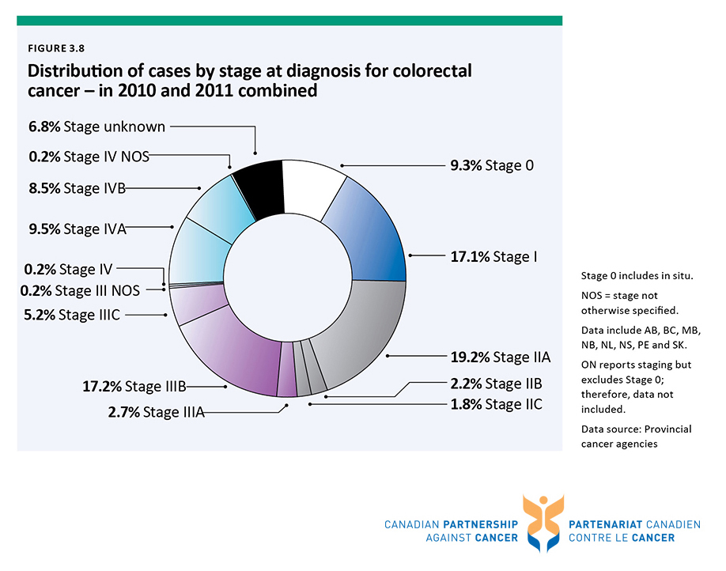

Slide 33
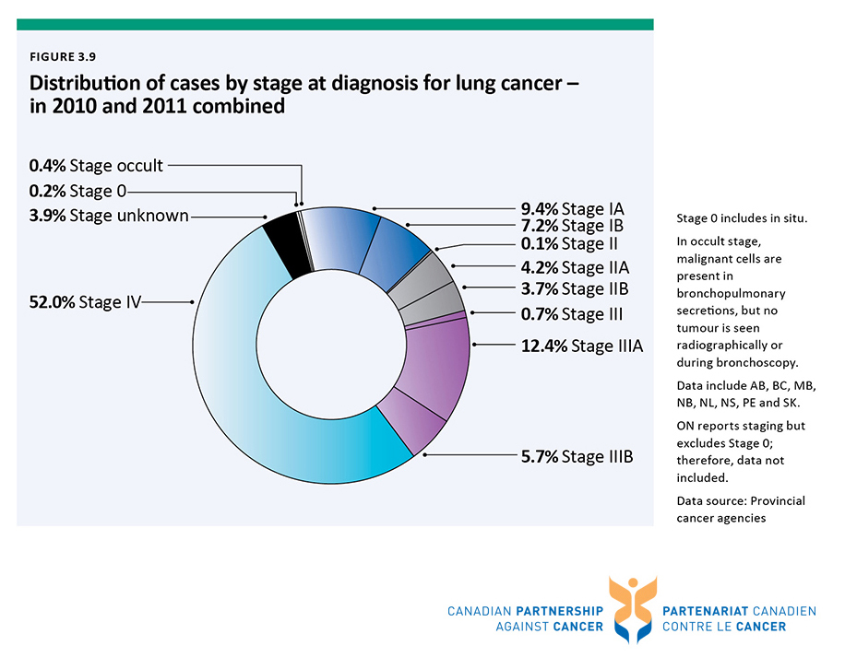

Slide 34
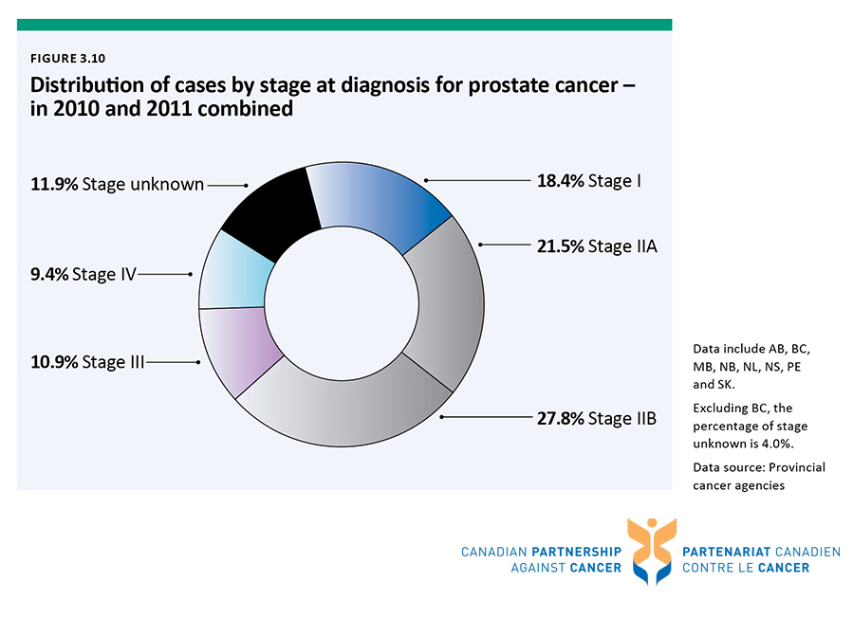

Slide 35
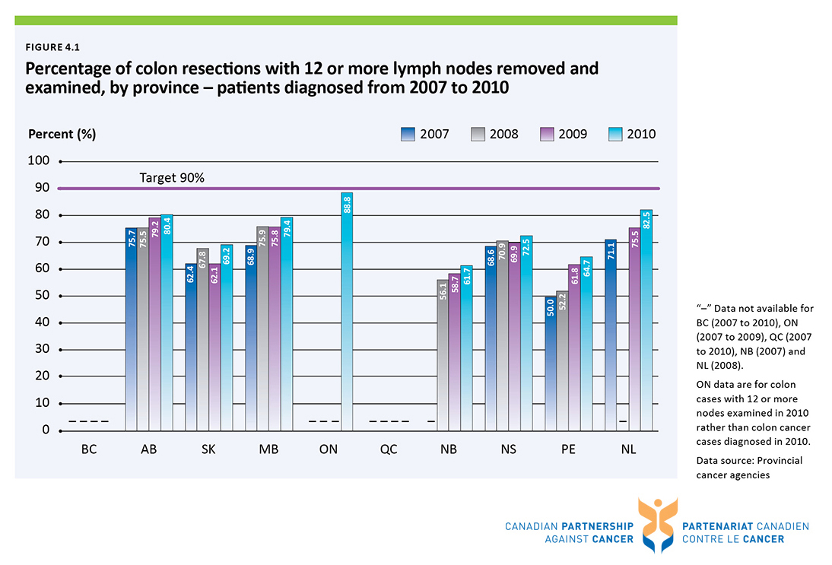

Slide 36
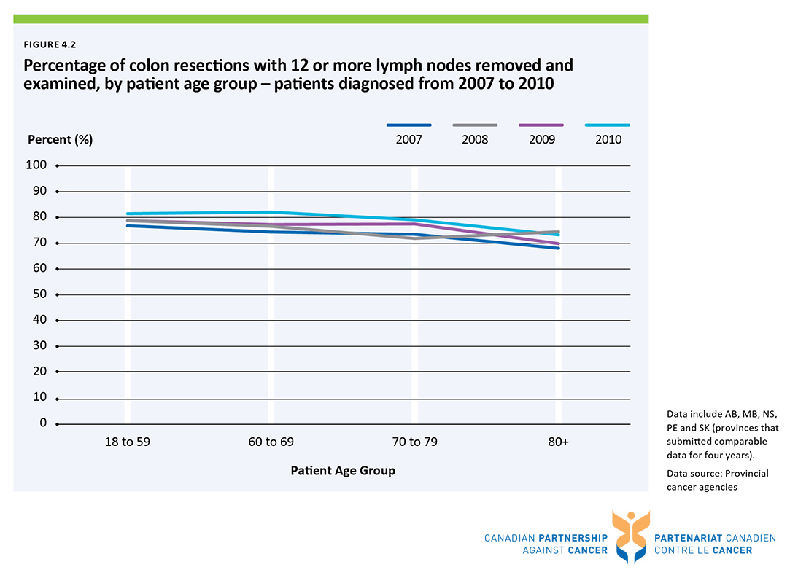

Slide 37
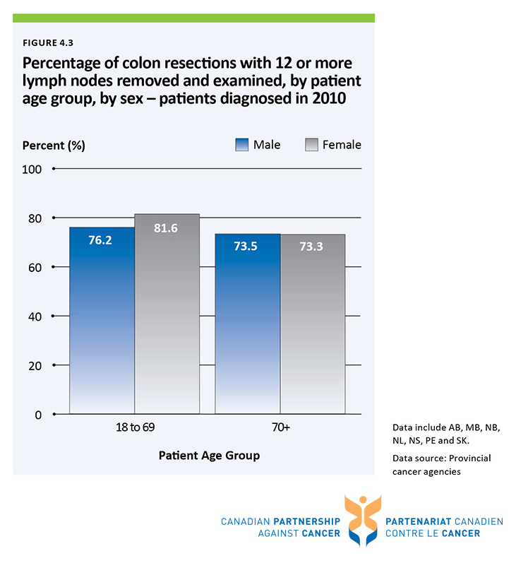

Slide 38
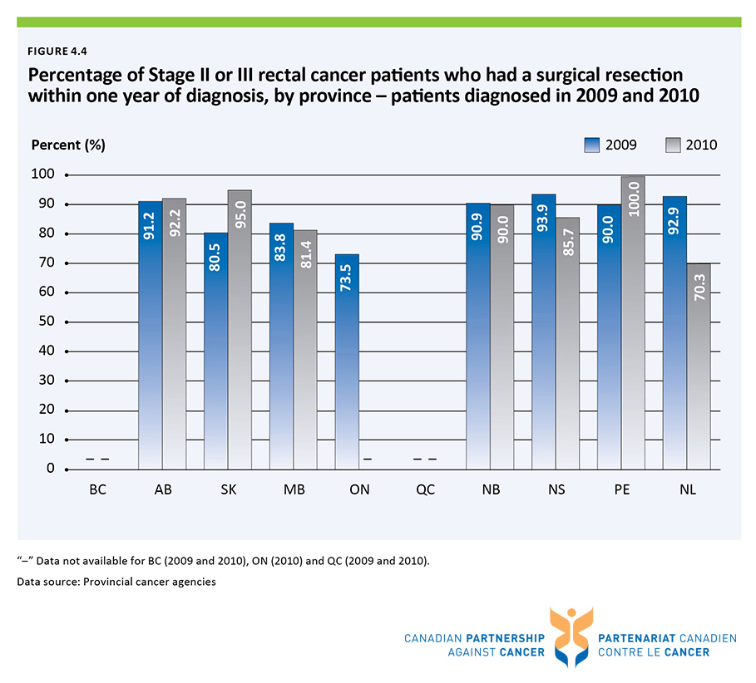

Slide 39
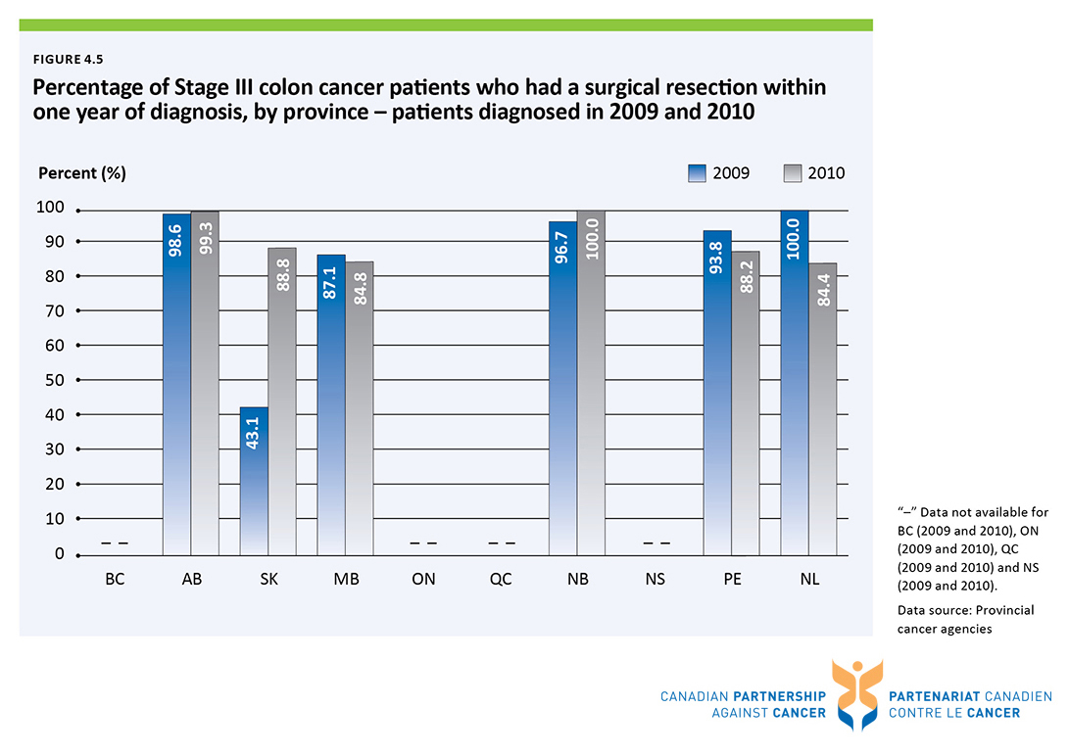

Slide 40
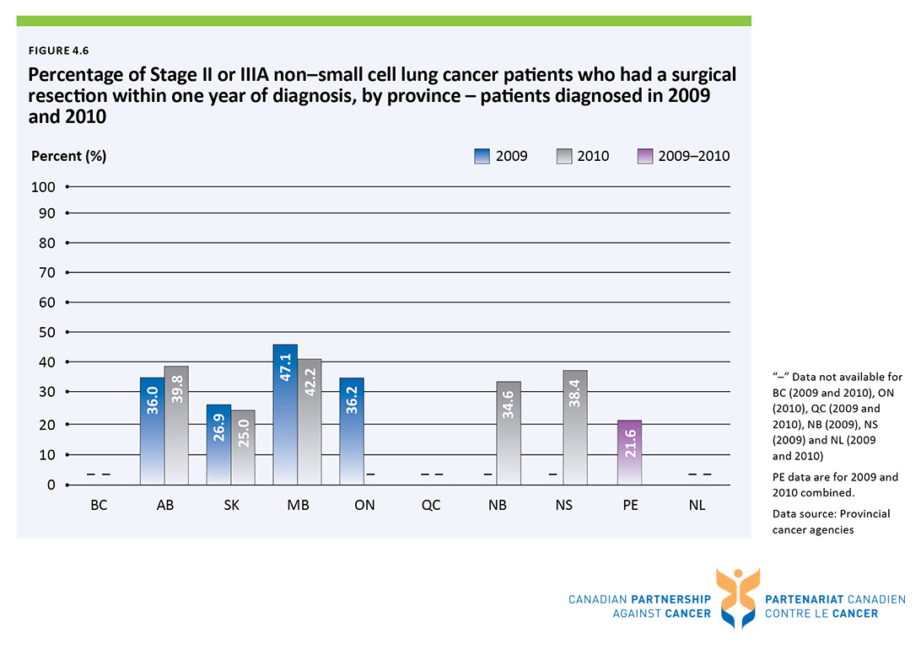

Slide 41
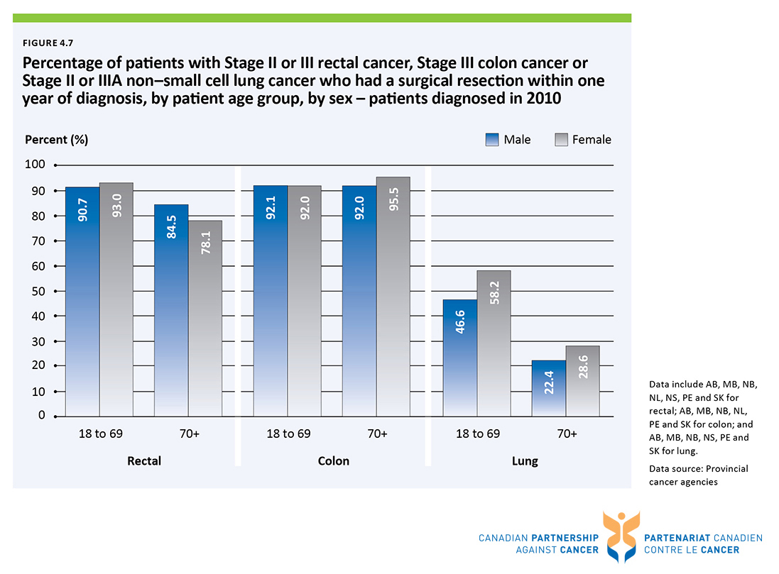

Slide 42
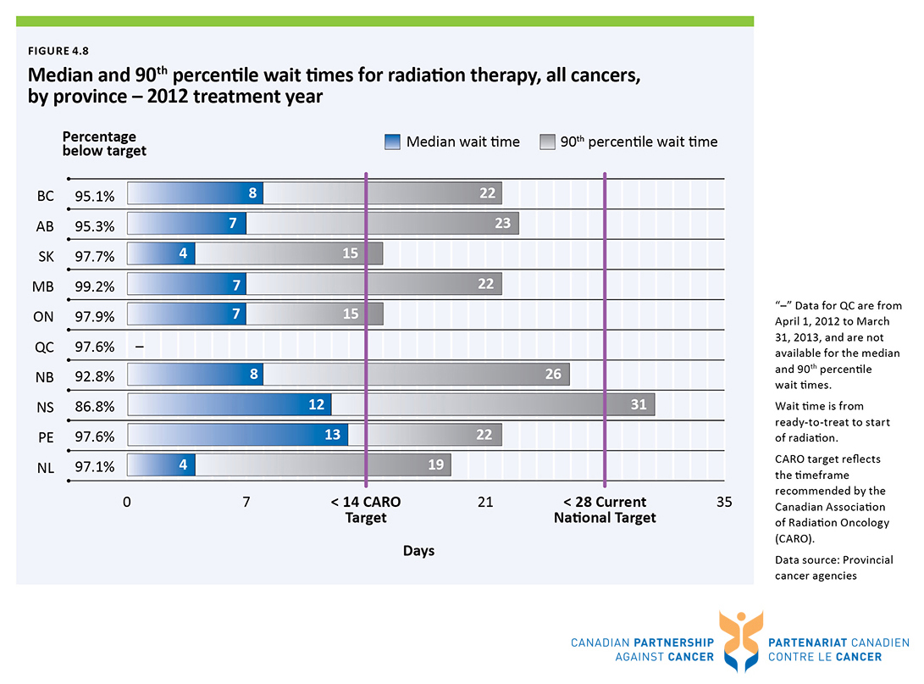

Slide 43
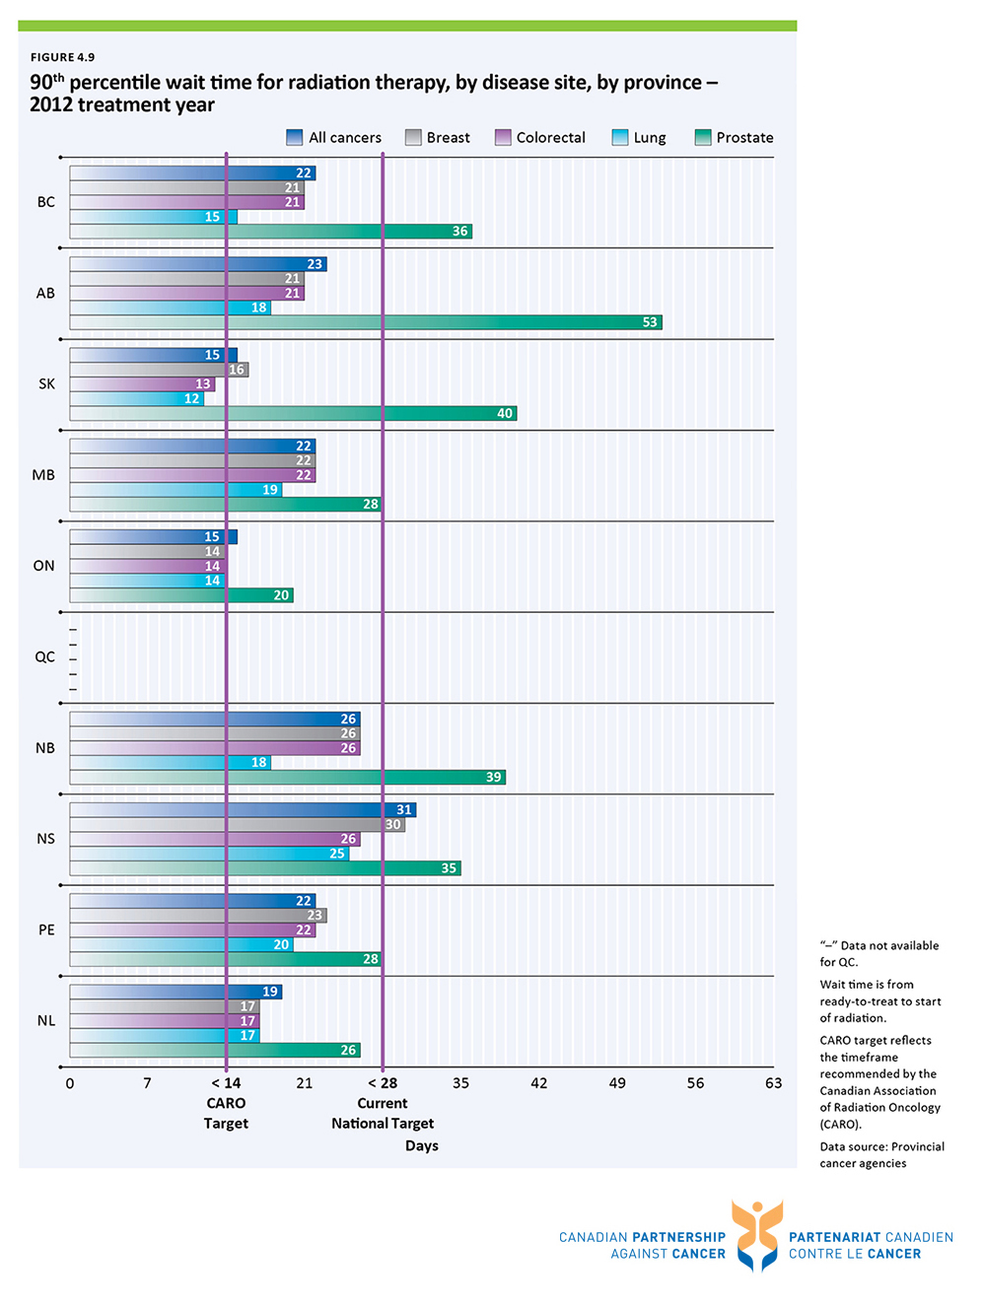

Slide 44
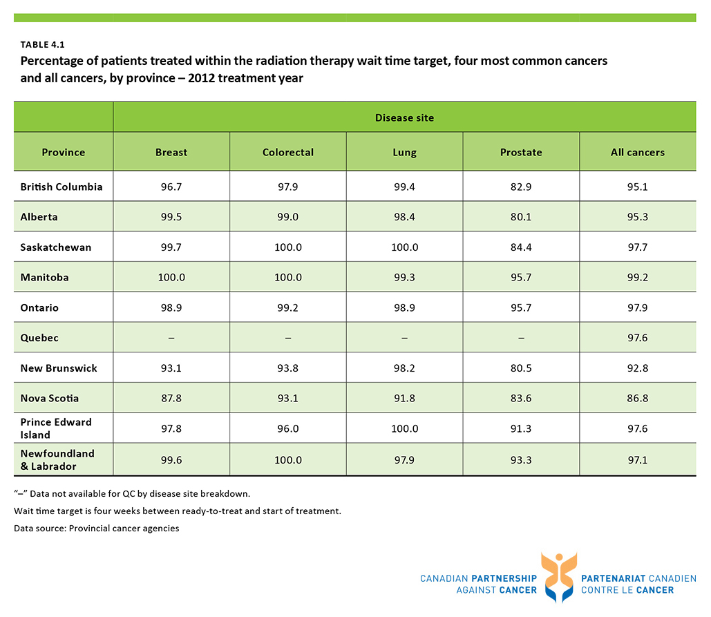

Slide 45
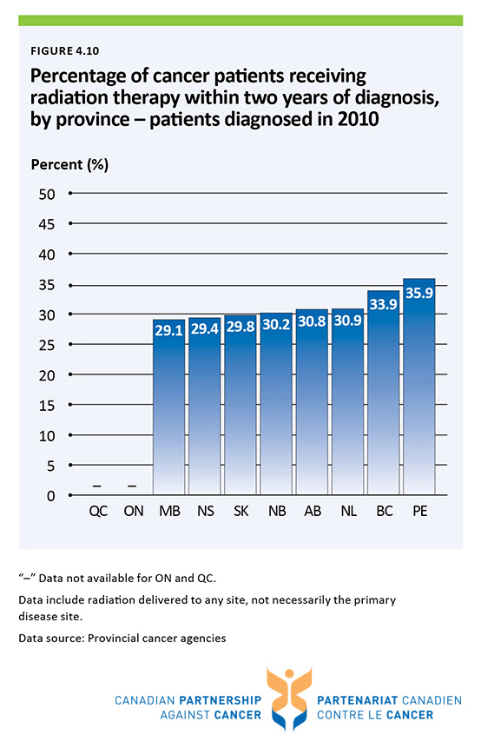

Slide 46
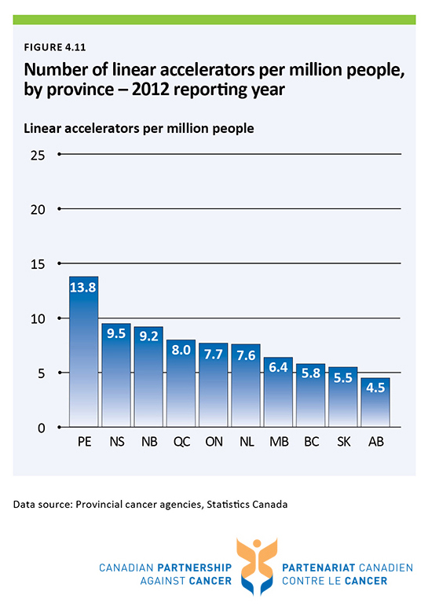

Slide 47
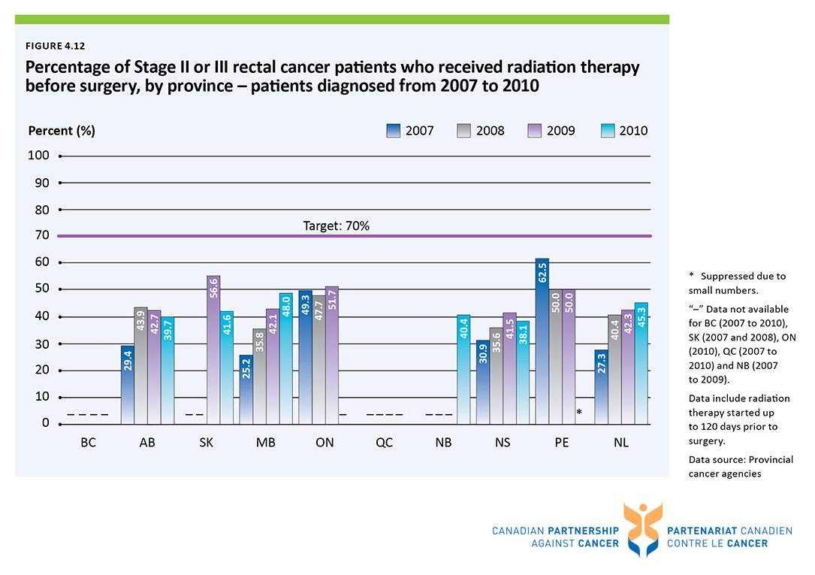

Slide 48
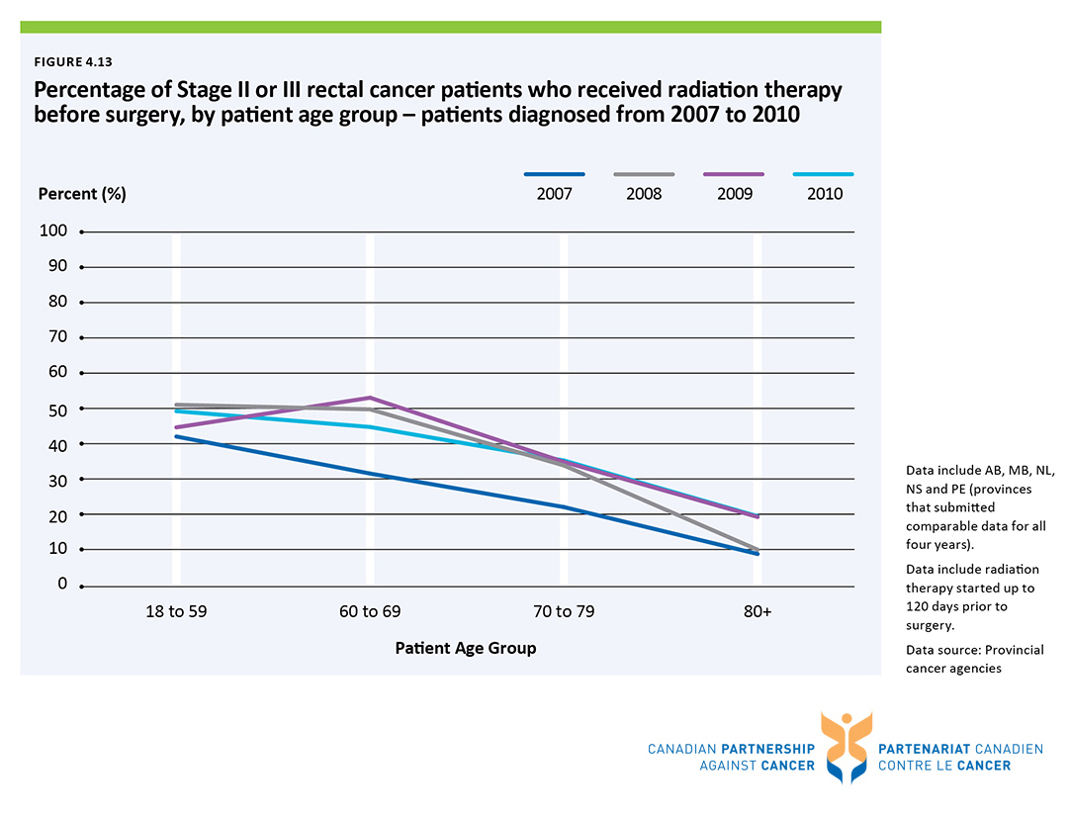

Slide 49
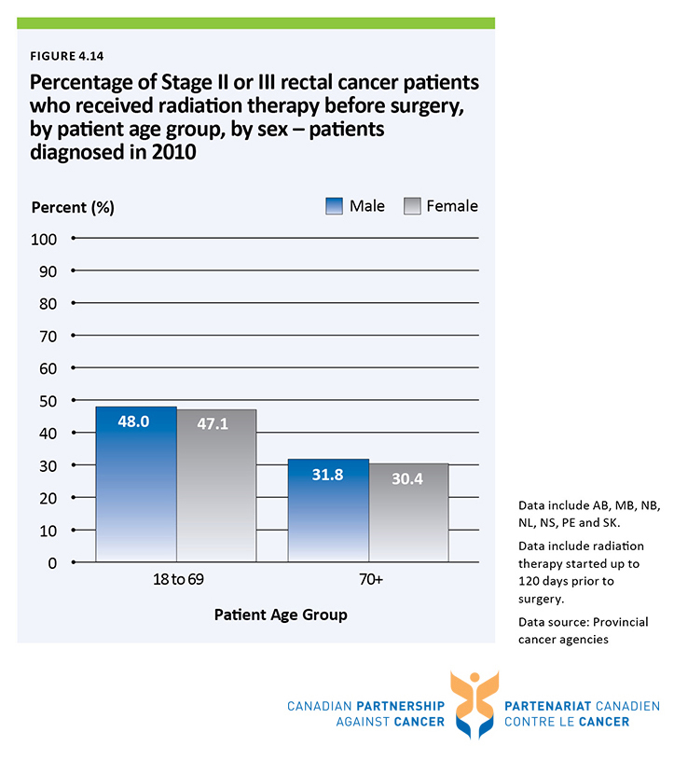

Slide 50
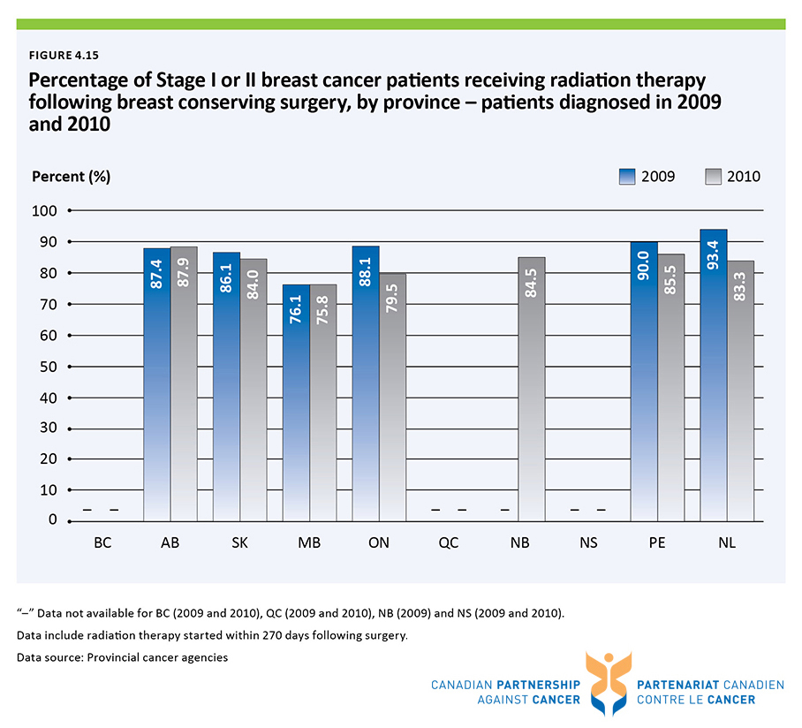

Slide 51
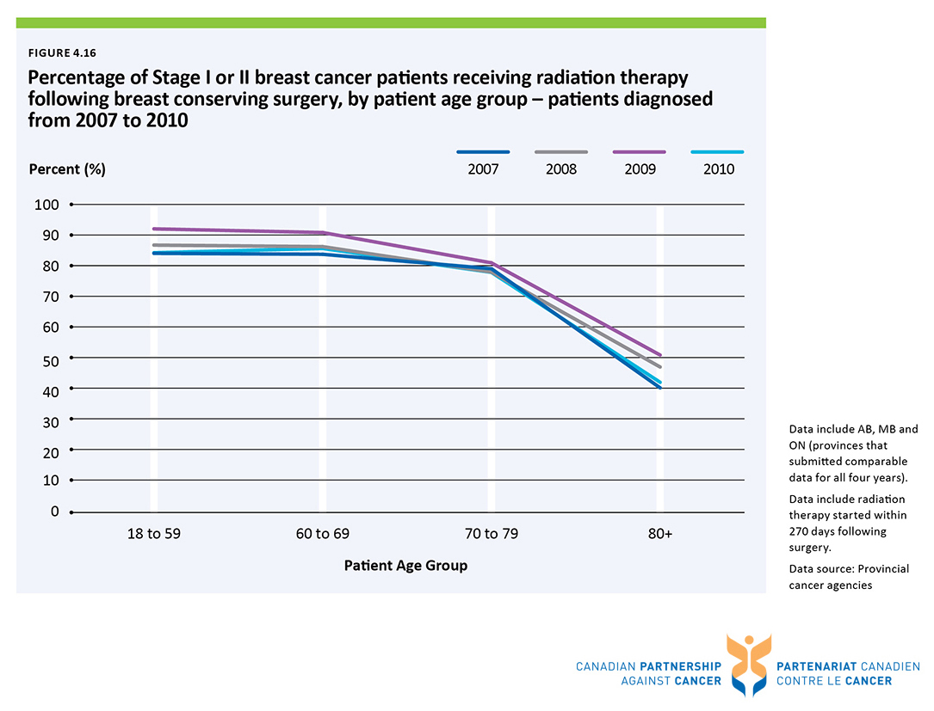

Slide 52
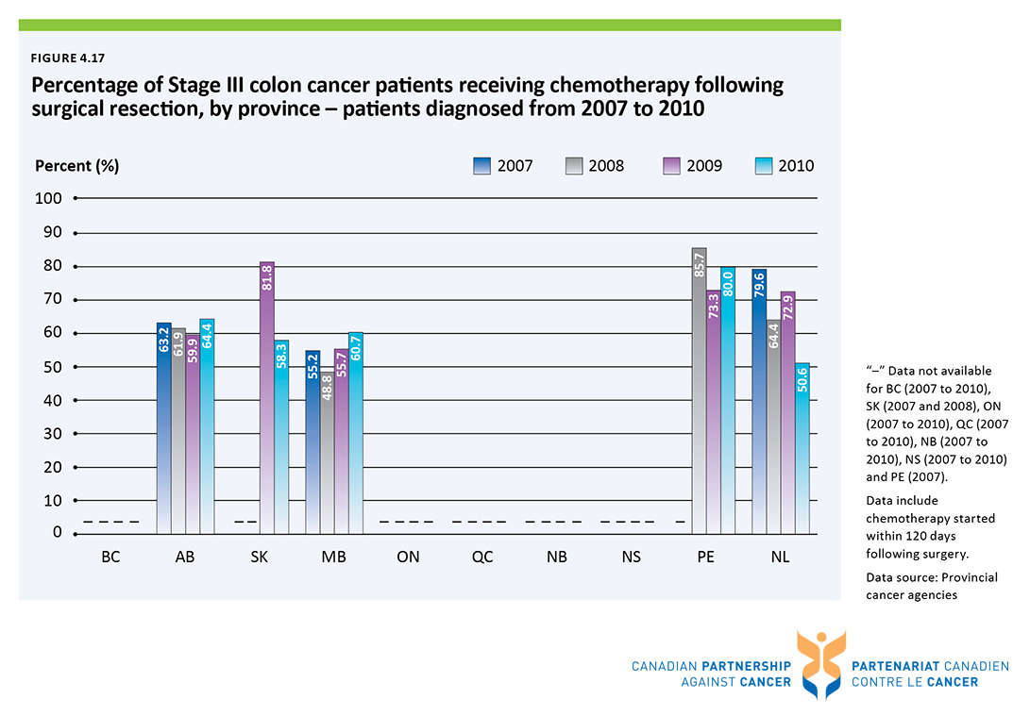

Slide 53
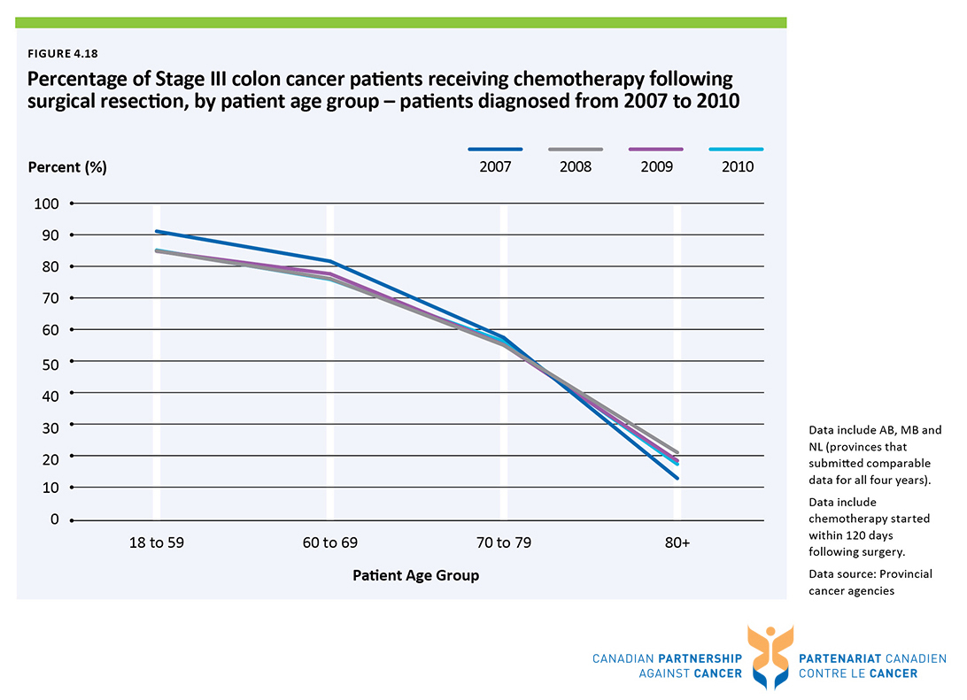

Slide 54
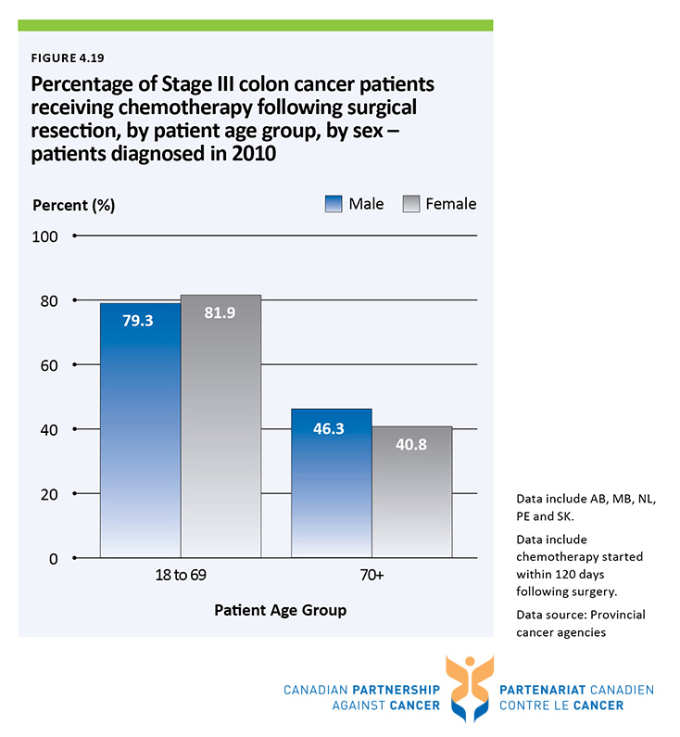

Slide 55


Slide 56


Slide 57


Slide 58


Slide 59


Slide 60


Slide 61


Slide 62


Slide 63


Slide 64


Slide 65


Slide 66


Slide 67


Slide 68


Slide 69


Slide 70


Slide 71


Slide 72


Slide 73


Slide 74


Slide 75


Slide 76


Slide 77


Slide 78


Slide 79


Slide 80


Slide 81


Slide 82


Slide 83


Slide 84


Slide 85


Slide 86


Slide 87


Slide 88


Slide 89


Slide 90


Slide 91


Slide 92


Slide 93


Slide 94


Slide 95


Slide 96


Slide 97


Slide 98


Slide 99


