Slide 1
Cancer Stage in Performance Measurement
To use a hyperlink, right click on it and select ‘Open Hyperlink’, or begin a Slide Show and click on the link.
Percentage of incident cases for which stage data are available in provincial registries, four most common cancers and all cancers, by province, 2011 diagnosis year.
Percentage of cases for which stage is unknown, by disease site and province, 2010 and 2011 diagnosis years.
Incidence rates for breast cancer in women, by stage at diagnosis, by province, age-standardized to the 2011 population, 2010 diagnosis year.
Incidence rates for colorectal cancer, by stage at diagnosis, by province, age-standardized to the 2011 population, 2010 diagnosis year.
Incidence rates for prostate cancer, by stage at diagnosis, by province, age-standardized to the 2011 population, 2010 diagnosis year.
Incidence rates for lung cancer, by stage at diagnosis, by province, age-standardized to the 2011 population, 2010 diagnosis year.
Percentage of invasive breast cancer cases (women aged ≥ 20) diagnosed as triple negative (ER,PR,HER2), by province, 2010 diagnosis year.
Distribution of non-metastatic prostate cancer cases (men aged ≥ 20) by risk category, by province, 2010 diagnosis year.
Percentage of invasive rectal cancer resections (patients aged ≥ 20) with a positive circumferential margin, by province, 2010 diagnosis year.

Slide 2
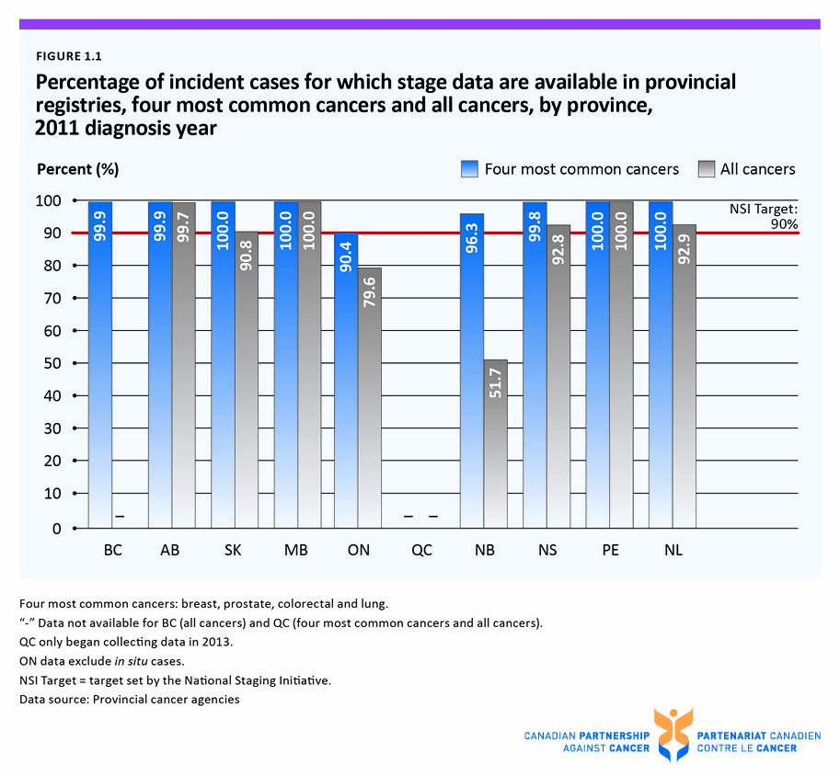

Slide 3
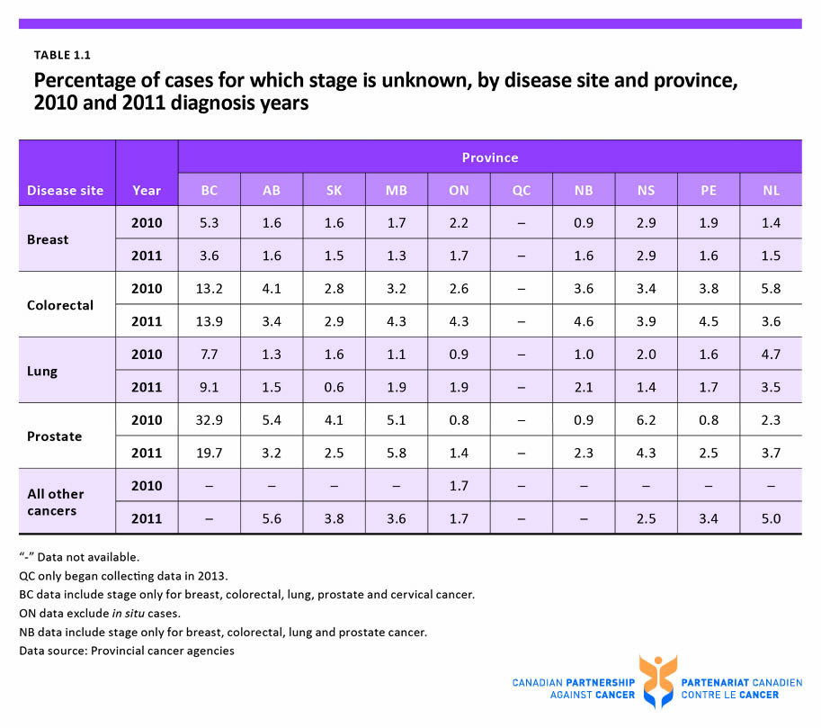

Slide 4
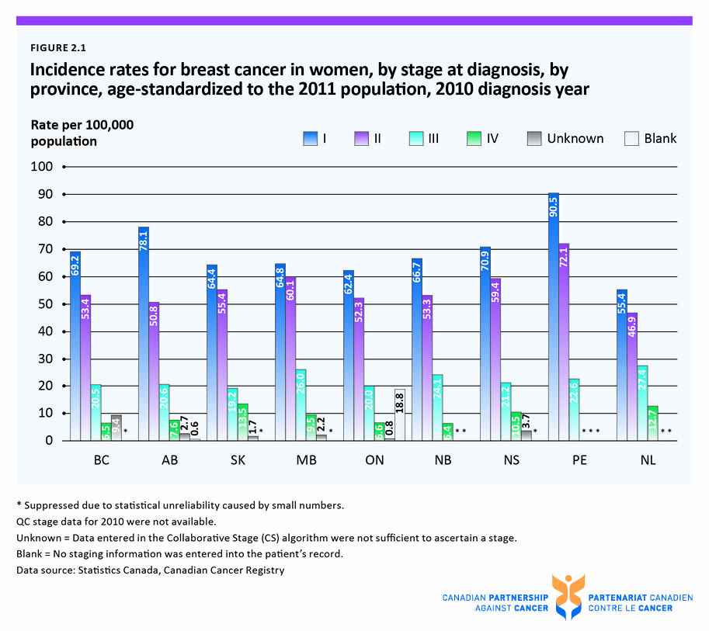

Slide 5
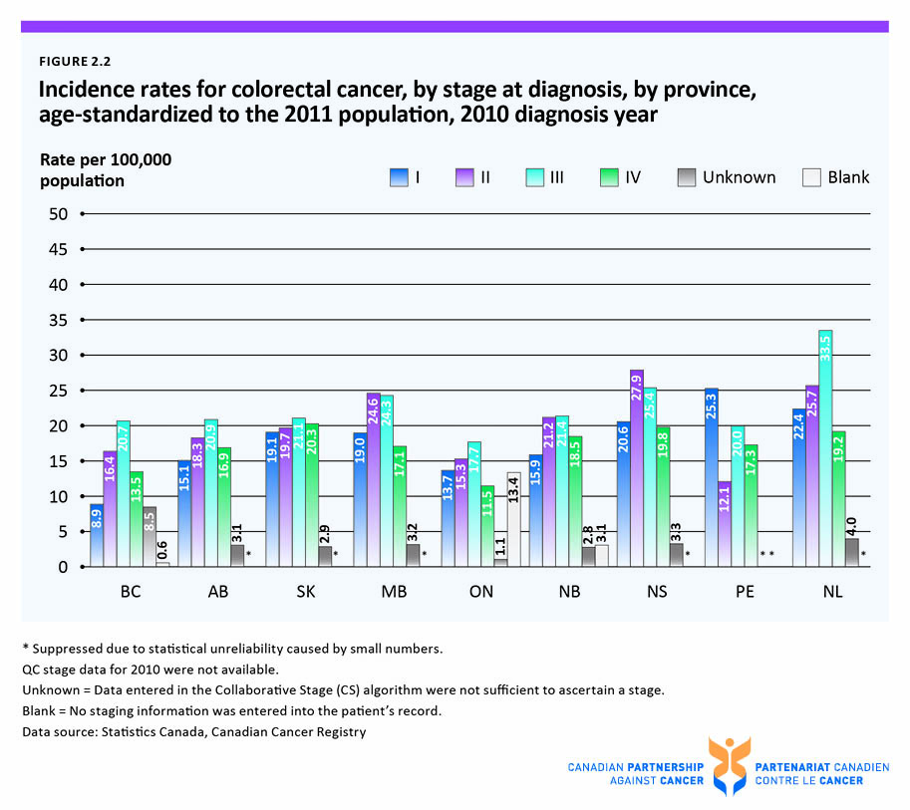

Slide 6
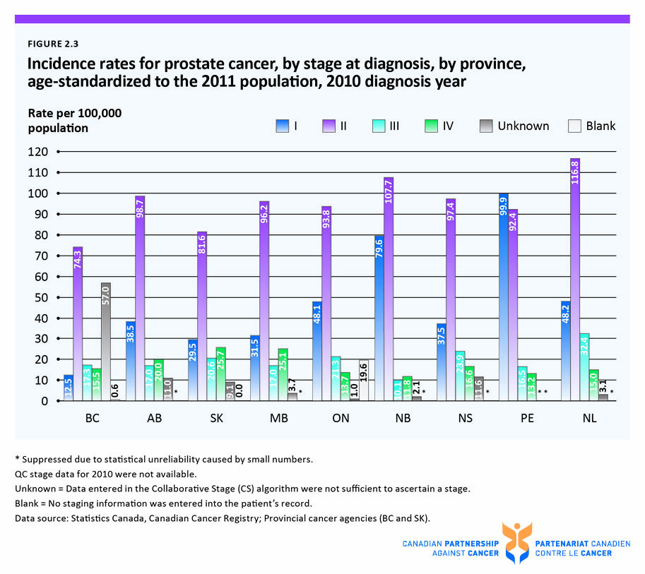

Slide 7
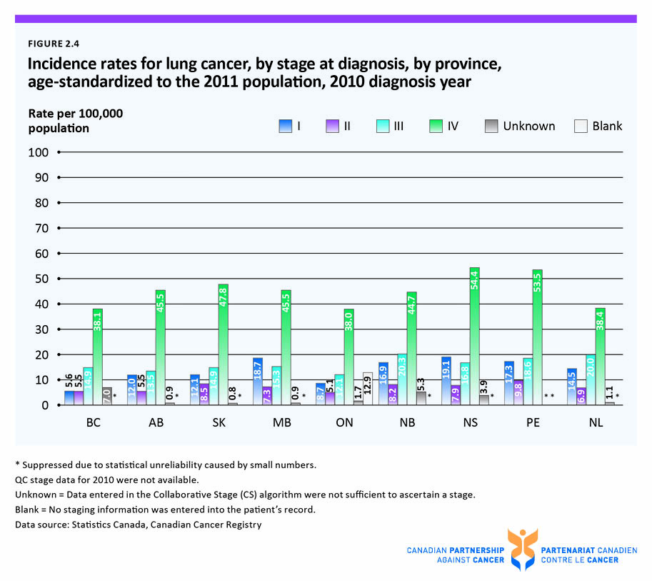

Slide 8
