Slide 1
Influencing Healthy Public Policies + the Prevention Policies Directory
Lecture Slides for Healthy Public Policy Course Instructors on:

Slide 2
Instructions for Course Instructors
Notes:
Notes to Instructors:
Delete slides 1 – 3, these are instructional in nature.

Slide 3
These lecture slides are designed to support course instruction on healthy public policy, please adapt as you wish
Refer to the Notes section of each slide to find source(s) of information, notes to instructors, background information and speaking notes
Notes:
Notes to Instructors:
Delete slides 1 – 3, these are instructional in nature.
These lecture slides are designed to support your course instruction on healthy public policy, please adapt as you wish.
Please refer to the Notes section of each slide to find:
source(s) of information,
notes to instructors,
background information and
draft speaking notes
A video and quick fact document on the Prevention Policies Directory tool is also available for graduate students in population and public health, please refer to slides 15 + 18

Slide 4
Influencing Healthy Public Policies

Slide 5
Public Health Policies are Ubiquitous
Notes:
Source:
World Health Organization, The Ottawa Charter for Health Promotion, First International Conference on Health Promotion, Ottawa, 21 November 1986
http://www.who.int/healthpromotion/conferences/previous/ottawa/en/
Speaking Notes:
It is well known that that public health policies, in the form of laws, have had an important effect on health status of populations.
Policy changes such as seatbelt laws or regulations governing permissible workplace exposures have had a profound impact on the health of our population.

Slide 6
Core Competencies for Public Health in Canada
Section 3.0: Policy + program planning, implementation + evaluation
A public health practitioner is able to:
Describe policy options to address a public health issues
Describe implications of options, including impacts on determinants of health + recommend/decide on a course of action
Develop a plan to implement a course of action taking into account relevant evidence, legislation, emergency planning procedures, regulations + policies
Implement a policy to address public health issues
Evaluate a policy
Source: Public Health Agency of Canada
Notes:
Source:
Public Health Agency of Canada
http://www.phac-aspc.gc.ca/php-psp/ccph-cesp/about_cc-apropos_ce-eng.php#a3_0
Speaking Notes:
To create a healthier Canada, knowledge of public health policies should be used effectively in your future role as public health professionals.
Background:
Section 3.0
Core Competencies needed to effectively choose options, and to plan, implement and evaluate policies and/or programs in public health. This includes the management of incidents such as outbreaks and emergencies.
A public health practitioner is able to:
3.1 Describe selected policy and program options to address a specific public health issue.
Front line provider: Identify potential school intervention programs and activities to address increasing rates of sexually transmitted infections among youth.
3.2 Describe the implications of each option, especially as they apply to the determinants of health and recommend or decide on a course of action.
Front line provider: Explore the social and economic implications of a folic acid education program directed at adolescents and decide whether or not to proceed.
3.3 Develop a plan to implement a course of action taking into account relevant evidence, legislation, emergency planning procedures, regulations and policies.
Consultant/specialist: Prioritize the components of a restaurant inspection logic model including appropriate rationale and develop the implementation plan for each component.
3.4 Implement a policy or program and/or take appropriate action to address a specific public health issue.
Consultant/specialist: Act according to the organization's emergency response plan in the event of an outbreak or emergency.
3.5 Demonstrate the ability to implement effective practice guidelines.
Front line provider: Use universal infection control measures appropriately.
3.6 Evaluate an action, policy or program.
Front line provider: Develop and implement an evaluation plan for a smoke-free workplace program in collaboration with stakeholders.
3.7 Demonstrate an ability to set and follow priorities, and to maximize outcomes based on available resources.
Front line provider: Set priorities for action on safer crack use in a local harm reduction program based on existing resources.
3.8 Demonstrate the ability to fulfill functional roles in response to a public health emergency.
Front line provider: Be familiar with the organization’s emergency management manual.
Manager/supervisor: Arrange a debriefing session after a public health incident to identify lessons learned and assess the need for recovery intervention for team members involved.

Slide 7
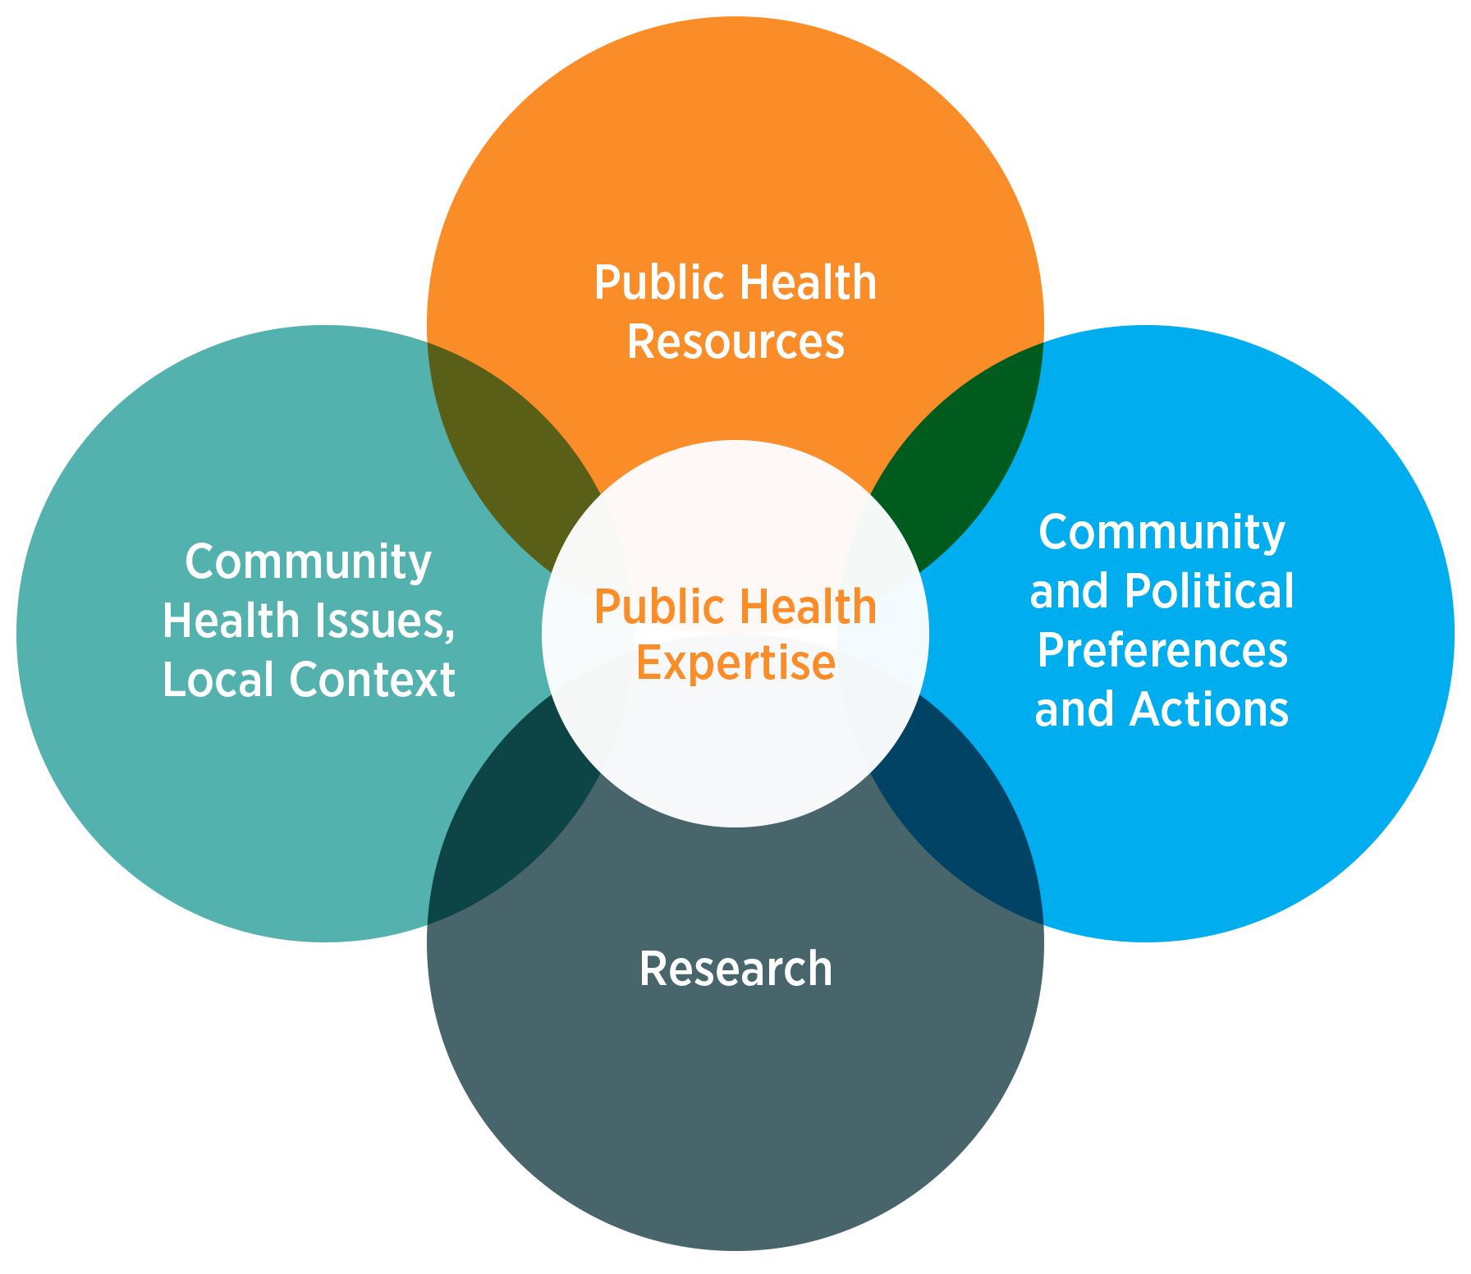
Evidence-informed Public Health
Using the best available evidence to inform healthy public policies
Source: National Collaborating Centre for Methods and Tools
Notes:
Source:
National Collaborating Centre for Methods and Tools
http://www.nccmt.ca/professional-development/eiph
Speaking Notes:
Evidence-informed decision making involves integrating the best available research evidence into the decision-making process. Additional factors – community health issues and local context; community and political preferences and actions; and public health resources – create the environment in which that research evidence is interpreted and applied.

Slide 8
Evidence-informed Public Health
Using the best available evidence to inform healthy public policies
Evidence-informed decision making in public health offers several potential benefits:
adoption of the most effective and cost-efficient interventions;
prudent use of scarce resources;
better health outcomes for individuals and communities.
Source: National Collaborating Centre for Methods and Tools
Notes:
Source:
National Collaborating Centre for Methods and Tools
http://www.nccmt.ca/professional-development/eiph
Speaking Notes:
Evidence-informed decision making in public health offers several potential benefits:
• adoption of the most effective and cost-efficient interventions;
• prudent use of scarce resources;
• better health outcomes for individuals and communities.
And, most importantly, public health’s use of evidence in decision-making has built its credibility in health and other sectors

Slide 9
Evidence-Informed Healthy Public Policy
How does evidence inform policy?
Notes:
Speaking Notes:
However, we know that public health problems and the best scientific evidence rarely (animation)
result in policy change… why is that?

Slide 10
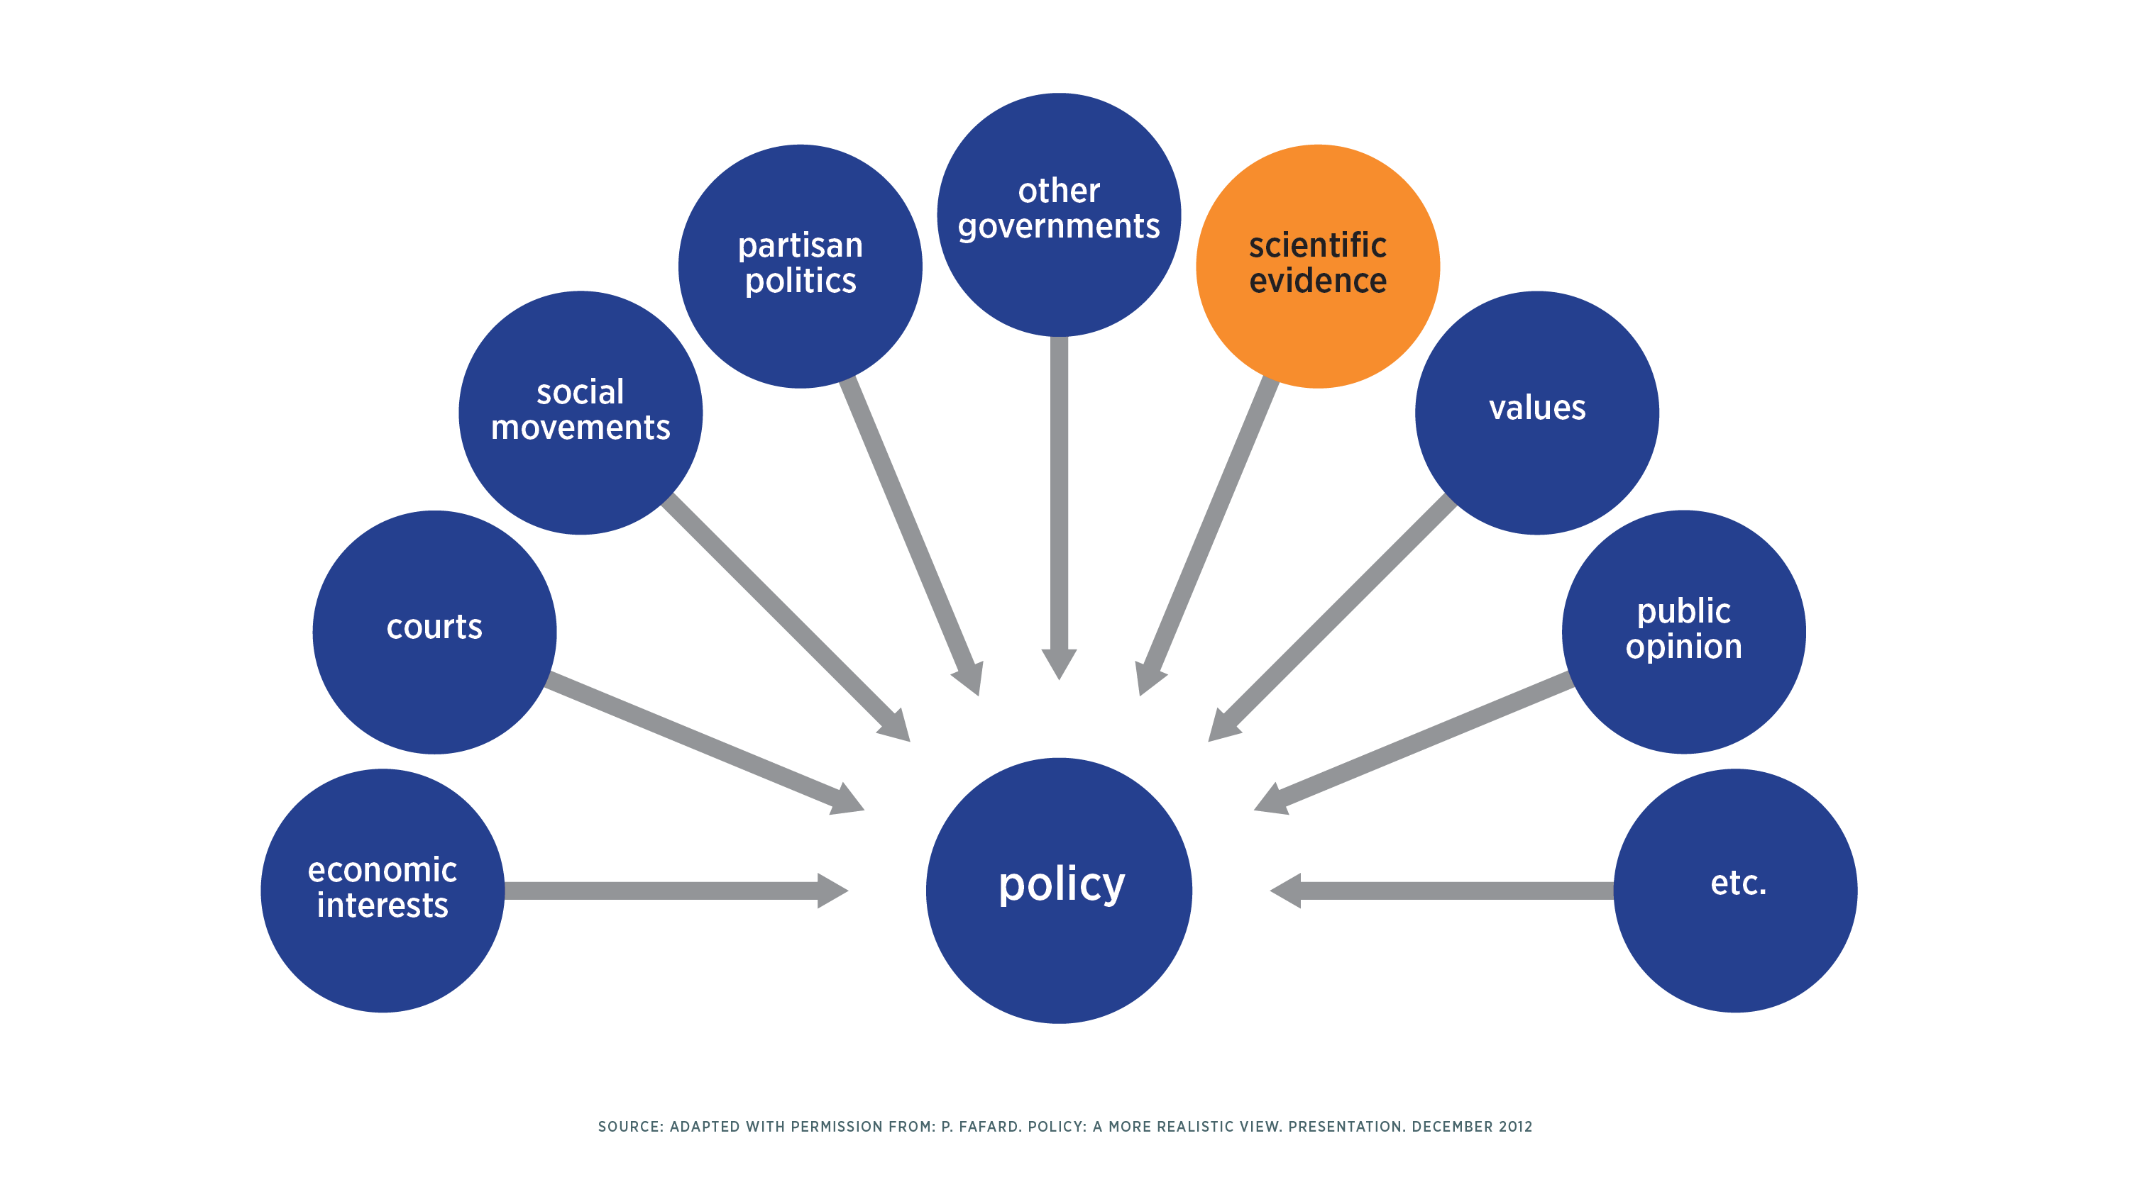
Evidence in Policymaking
A MORE REALISTIC VIEW?
Source: Adapted with permission from: P. Fafard. Policy: a more realistic view. Presentation. December 2012
Notes:
Source:
Adapted with permission from Patrick Fafard’s Policy: a more realistic view presentation for Canadian Partnership Against Cancer. December 2012.
Speaking Notes:
Well, to start… evidence is only one of many considerations in policymaking and not necessarily the most important… if public health practitioners wish to establish policies to improve the health of populations, understanding all of the factors that influence policymaking is crucial….
For instance, let’s consider other governments… (animation)

Slide 11
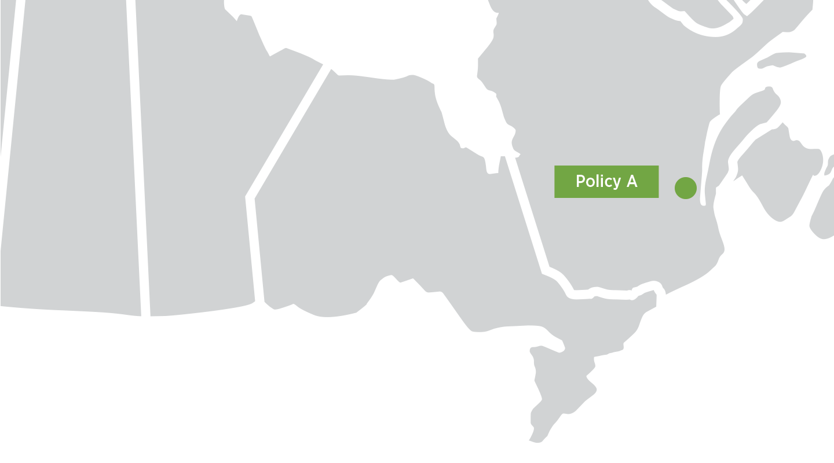
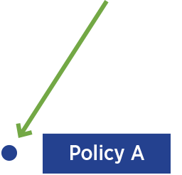
Policy Diffusion
Source: Worman, Margaret, "Responding to the Affordable Care Act:
Health Insurance Exchange Policy Diffusion" (2013). Honors Projects. Paper 40.
Notes:
Source:
Worman, Margaret, "Responding to the Affordable Care Act: Health Insurance Exchange Policy Diffusion" (2013). Honors Projects. Paper 40.
http://digitalcommons.macalester.edu/poli_honors/40
Speaking Notes:
Policies that support population health are often developed in one jurisdiction by learning from what has worked well in another.
Background:
Policy diffusion is about the movement of a policy across jurisdictional boundaries. In diffusion, decision makers 'learn' policy solutions and/or draw on others' experiences to evaluate the effectiveness and appropriateness of a public policy for their own jurisdiction. It can be more efficient for a jurisdiction to model themselves after others rather than to undertake the policy development cycle for each specific issue.
Several factors can influence the diffusion of policy, these include:
Geographic Proximity: Existence of a public policy in nearby cities or provinces/territories provides a model upon which officials can draw and can make the enactment of the policy more likely
Imitation: Diffusion may be driven by shared attributes of jurisdictions (e.g., political, ideological, demographic, cultural, or economic similarities)
Emulation: A policy may diffuse because officials view an existing successful version elsewhere and try to copy its success in their own jurisdiction. Emulation is driven by perceived success of a policy. Successful jurisdictions are more likely to be emulated, regardless of geographic proximity.
Competition: Policies may diffuse because officials believe the failure to adopt them will put their jurisdiction at a competitive disadvantage. There is an element of pressure to keep up with colleagues in other jurisdictions. It has been observed that innovative policies may diffuse more rapidly through time and space.

Slide 12
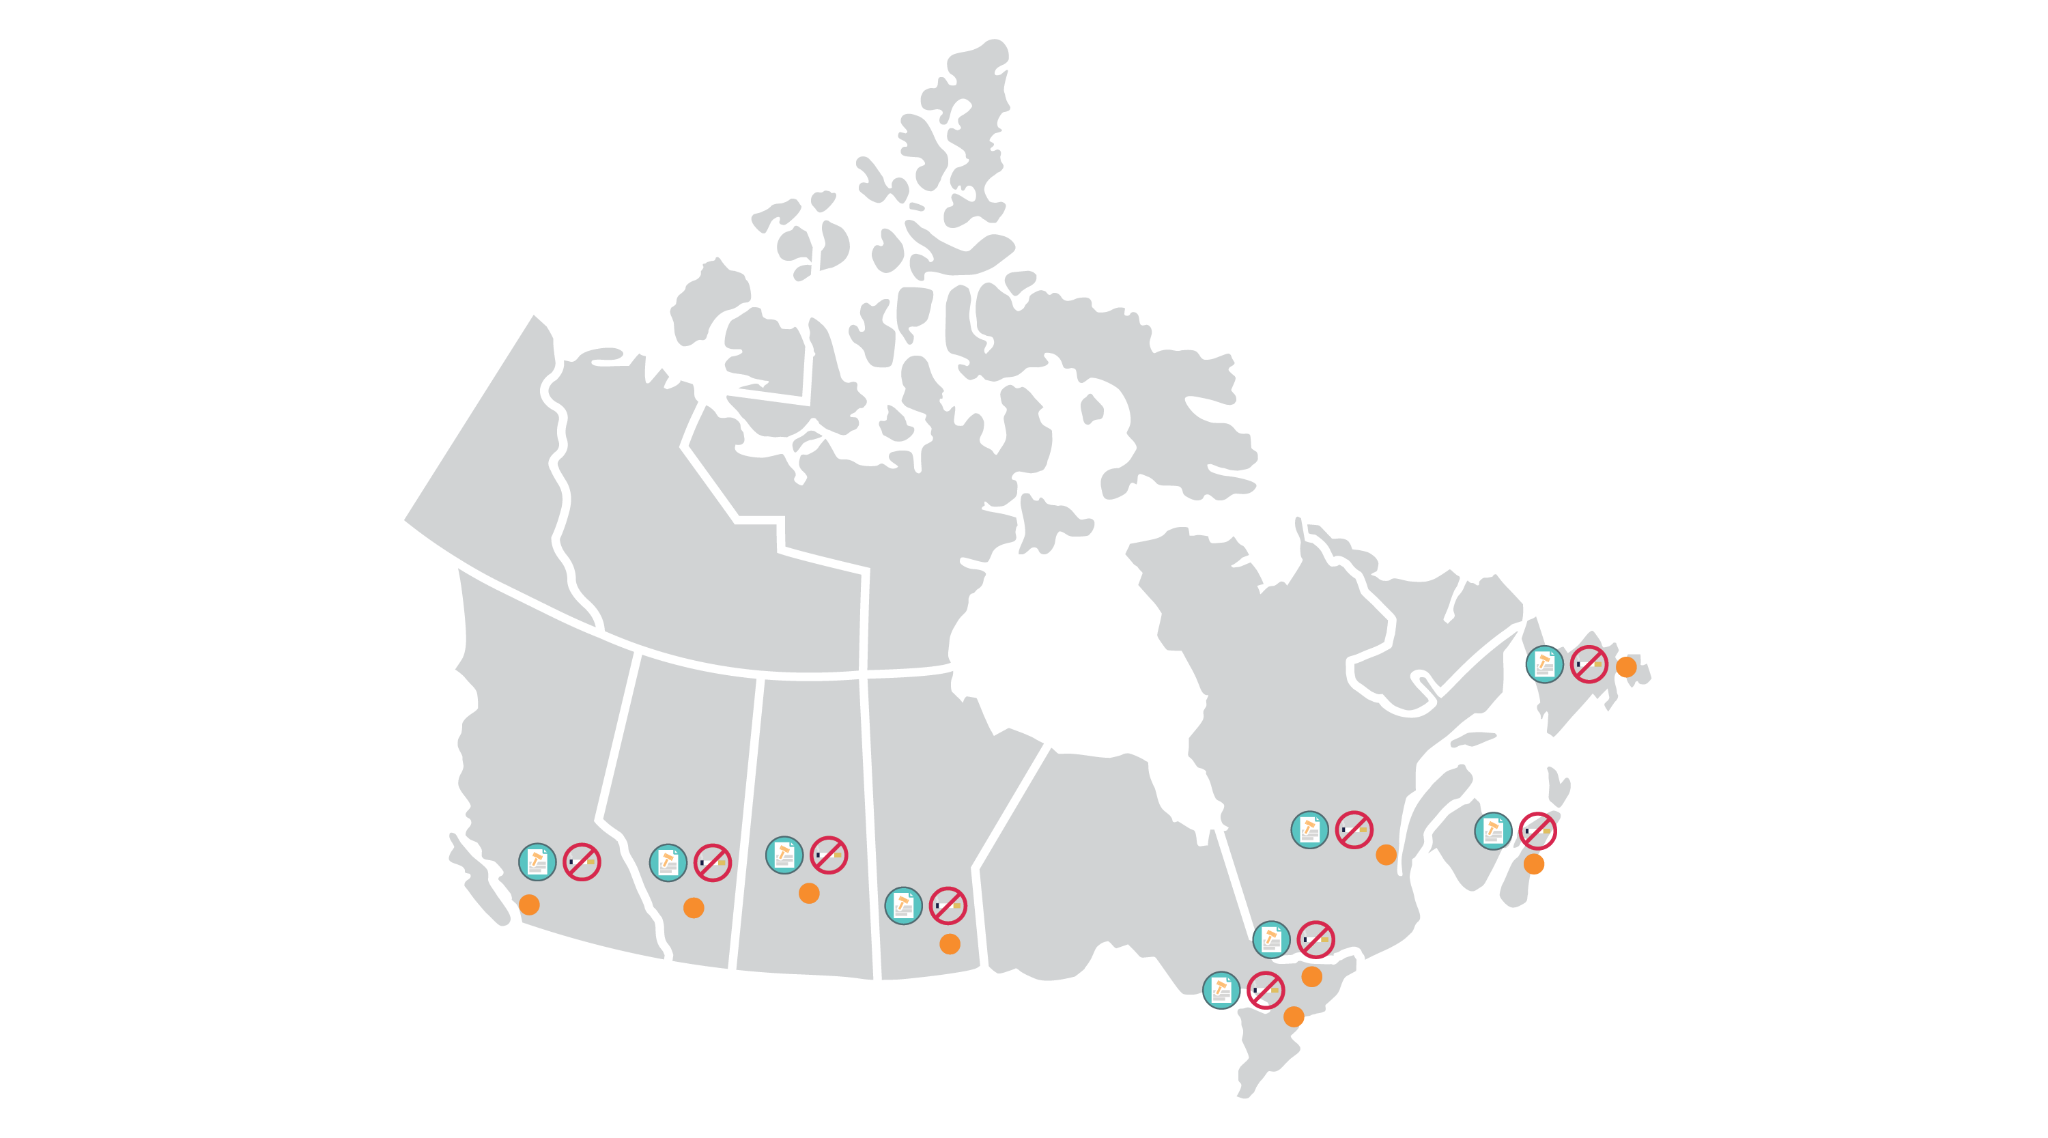
Policy Diffusion — Example
Notes:
Source:
Canadian Public Health Association
http://www.cpha.ca/en/programs/history/achievements/08-tu/smoke-free.aspx
Speaking Notes:
For example, it all started with one when it comes to laws on smoke-free spaces.
The first municipal smoke-free spaces bylaw in Canada was introduced in 1976 in the City of Ottawa, and soon after in 1977, the City of Toronto, ON followed suit, and by the 1980s more and more municipal smoke-free space bylaws were popping up across Canada…
You might wonder how you might find policies to learn from… Googling might be your first stop, but there’s a smarter way to access policies that influence population and public health…

Slide 13
There’s a tool for that!
Notes:
Speaking Notes:
As you prepare for your future career in public health, there’s a new tool that can help you easily find and access policies from across Canada

Slide 14
Notes:
Source:
www.cancerview.ca/preventionpolicies
Politis, C. E., Halligan, M. H., Keen, D., & Kerner, J. F. (2014). Supporting the diffusion of healthy public policy in Canada: the Prevention Policies Directory. Online Journal of Public Health Informatics, 6(2), e177.
Speaking Notes:
The Canadian Partnership Against Cancer has created the Prevention Policies Directory—a powerful, bilingual tool designed to centralize cancer and chronic disease prevention policies and make knowledge sharing simple, easy, and fast.

Slide 15
Notes:
Note to Instructor:
Use Slide 15 (and play embedded video) in place of slides 16 -17 to describe the Prevention Policies Directory and how it is useful to students.

Slide 16
The Prevention Policies Directory
Search Technology
Expert Human Curation
Notes:
Source:
www.cancerview.ca/preventionpolicies
Politis, C. E., Halligan, M. H., Keen, D., & Kerner, J. F. (2014). Supporting the diffusion of healthy public policy in Canada: the Prevention Policies Directory. Online Journal of Public Health Informatics, 6(2), e177.
Speaking Notes:
By combining sophisticated and highly targeted search technology with expert human curation, the Directory offers thousands of policy documents across risk factors, policy types, jurisdictions, and geographic locations. And it’s growing every day, updating content as it becomes available.

Slide 17
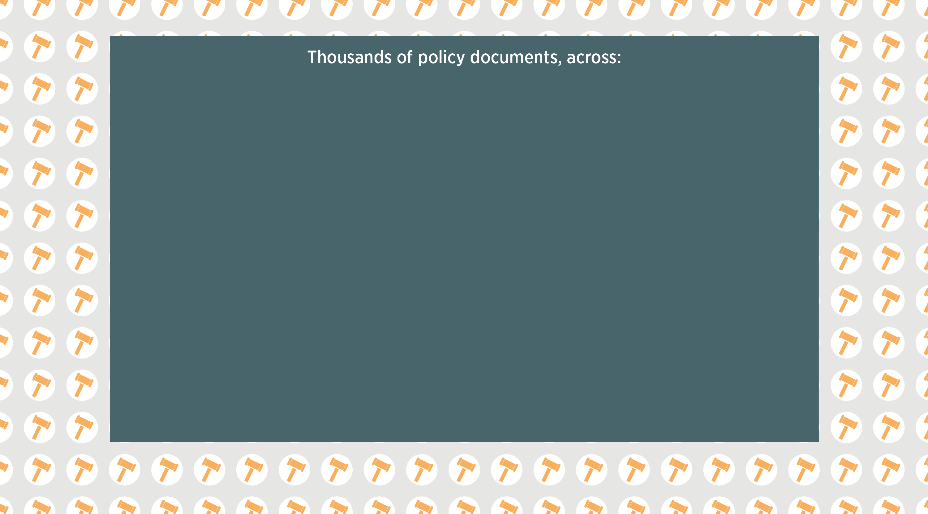
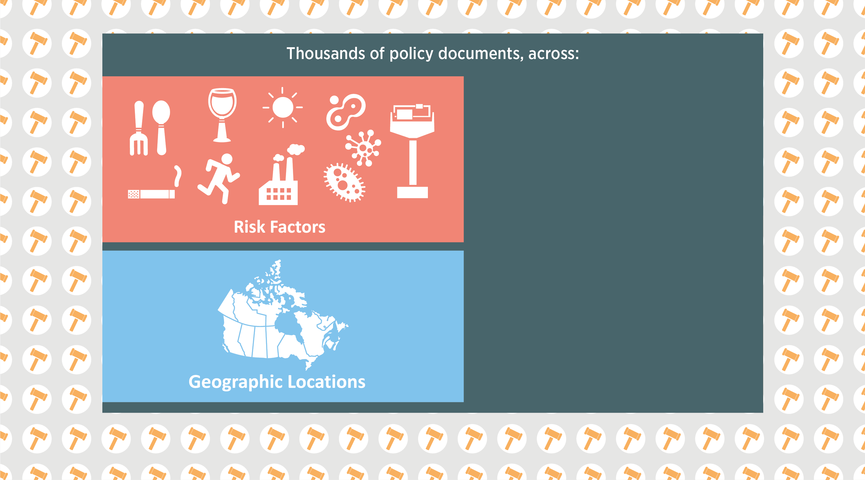
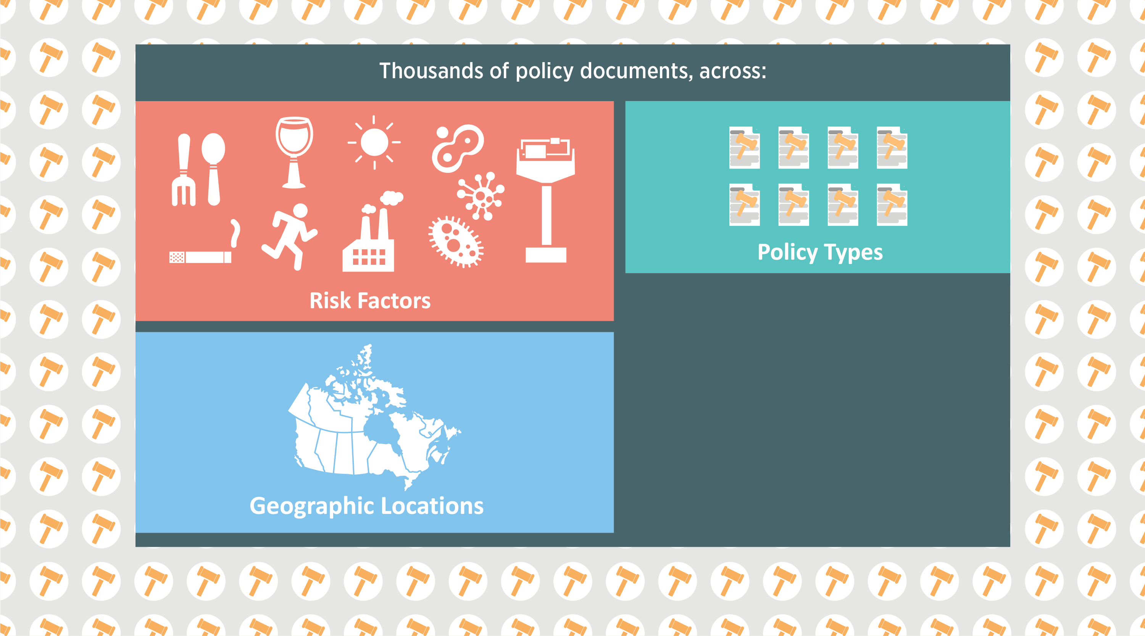
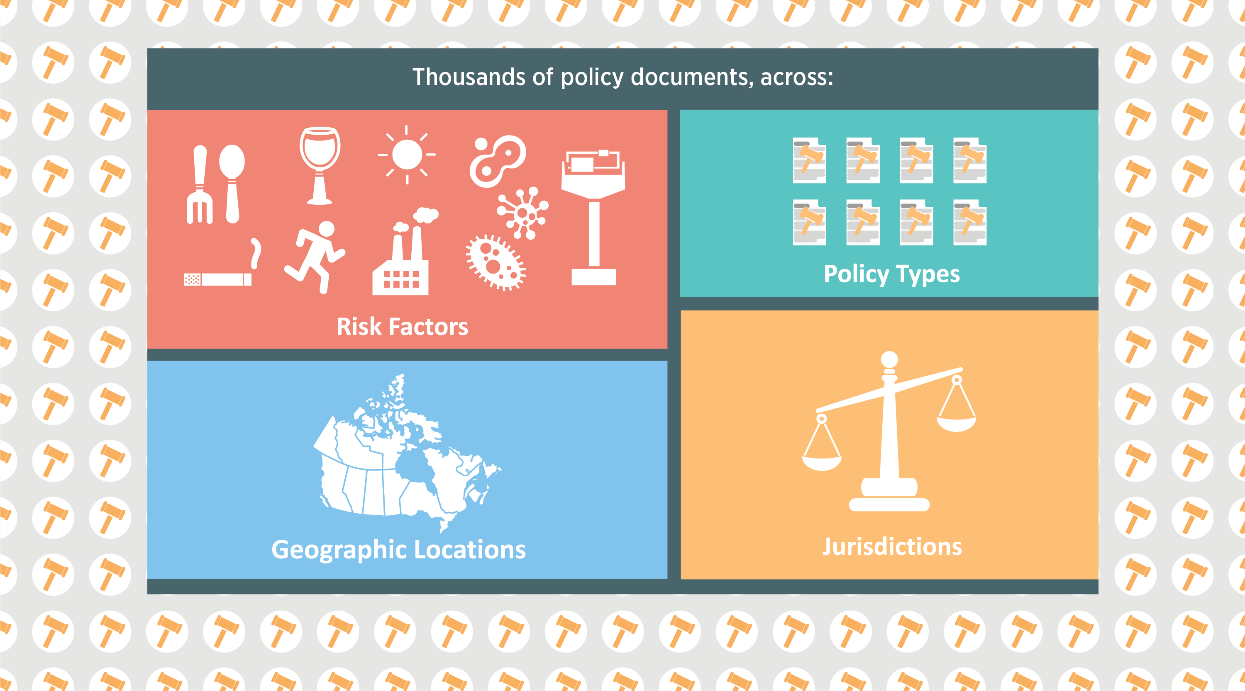
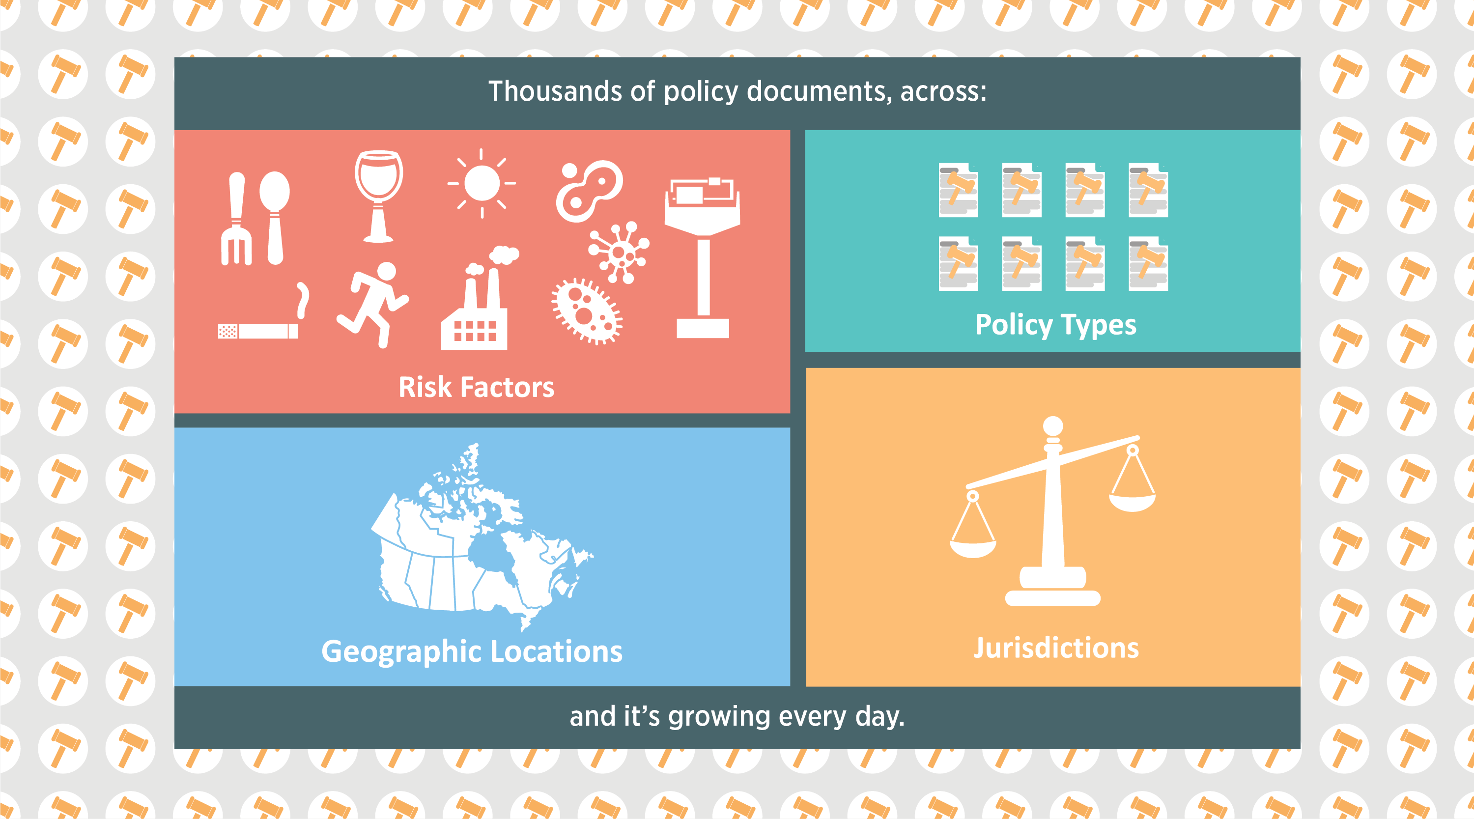
The Prevention Policies Directory

Slide 18
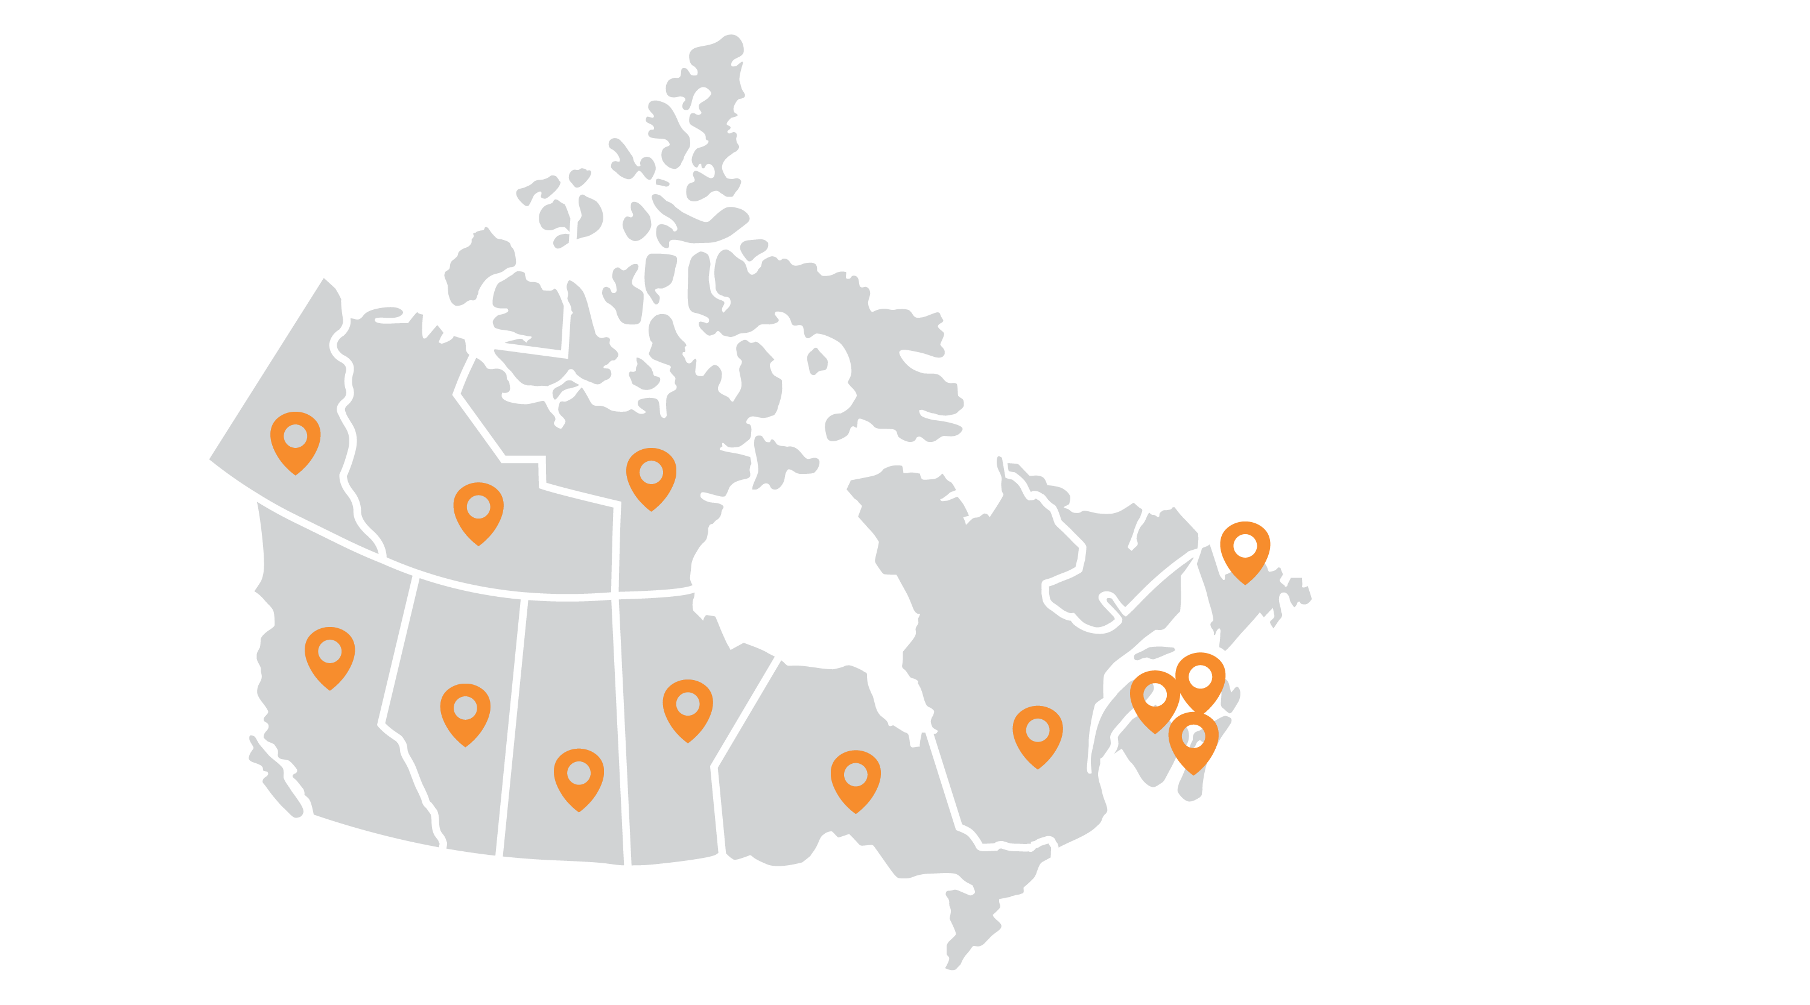
Put the Directory to work for you
Notes:
Speaking Notes:
The Prevention Policies Directory can be used in your coursework and your future career in public health, not only to develop briefing notes but also for environmental scanning and policy surveillance, as a starting point for policy analysis and evaluation, and much more.

Slide 19
Resources
Notes:
Source:
http://www.cancerview.ca/preventionandscreening/preventionpoliciesdirectory/resources-for-students/
Speaking Notes:
Put the Prevention Policies Directory to work for you now and in your future career in public health. Visit this page to find a handy fact sheet on using the Directory, as well as a short video on the value of the tool.

Slide 20
Assignment
Notes:
Notes to Instructors:
If applicable to your course, please select one of the pre-developed assignments from http://www.cancerview.ca/preventionandscreening/preventionpoliciesdirectory/ppdusingthedirectory/resources-for-faculty/ and insert instructions in this section.
If not applicable, delete slides 19 – 20.

Slide 21
Sample Assignment
Notes:
Notes to Instructors:
Please select one of the pre-developed assignments from http://www.cancerview.ca/preventionandscreening/preventionpoliciesdirectory/ppdusingthedirectory/resources-for-faculty/ and insert instructions here.

Slide 22
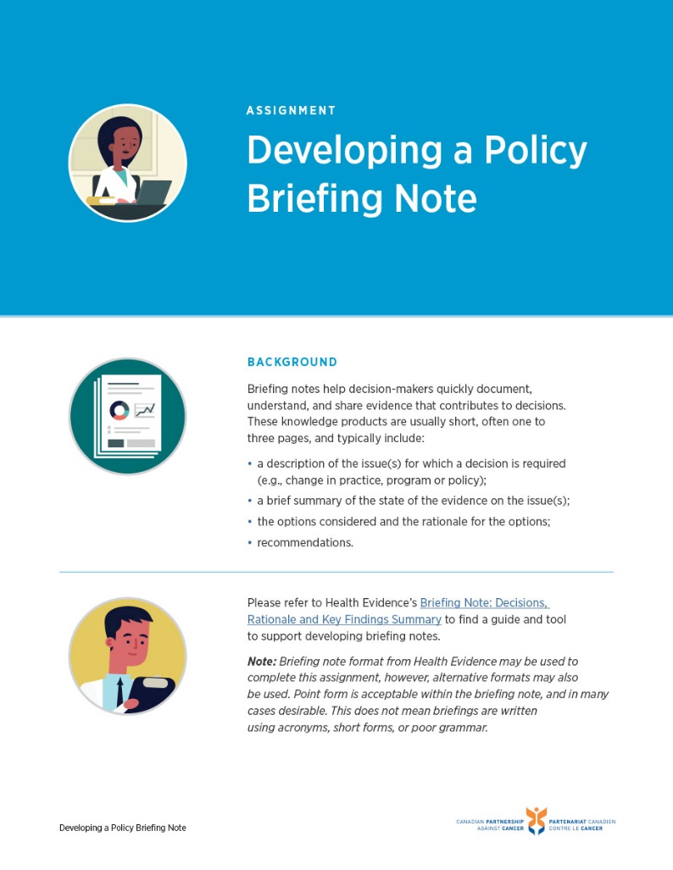
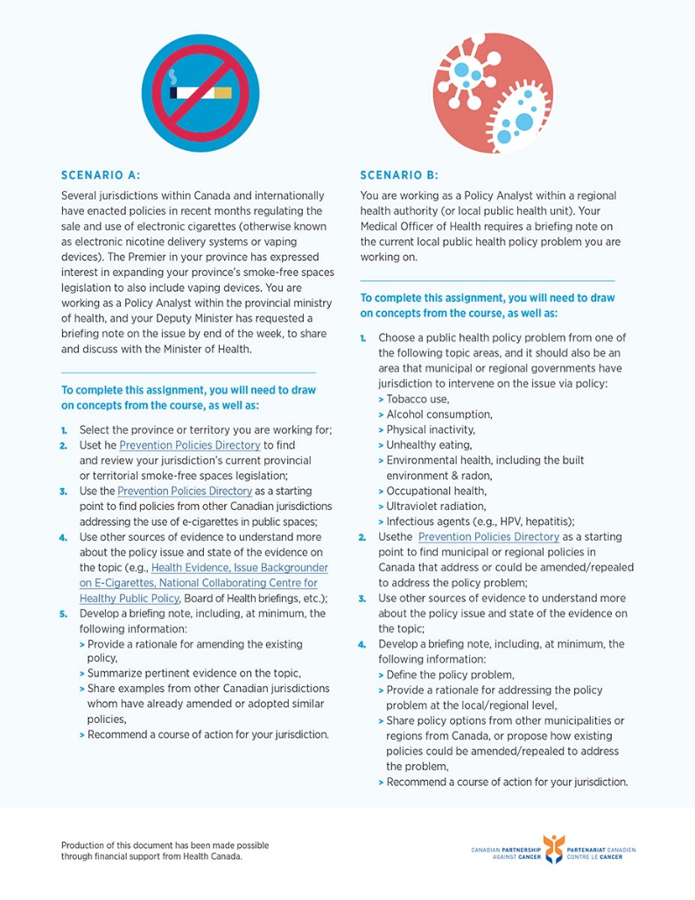
Sample Assignment

Slide 23
Sample Assignment
Scenario B
You are working as a Policy Analyst within a regional health authority (or local public health unit). Your Medical Oﬃcer of Health requires a briefing note on the current local public health policy problem you are working on.
Choose a public health policy problem from one of the topic areas;
Use the Prevention Policies Directory as a starting point to find municipal or regional policies in Canada that address or could be amended/repealed to address the policy problem;
Use other sources of evidence to understand more about the policy issue and state of the evidence on the topic;
Develop a briefing note
Topic Areas
Tobacco use,
Alcohol consumption,
Physical inactivity,
Unhealthy eating,
Environmental health, including the built environment & radon,
Occupational health,
Ultraviolet radiation,
Infectious agents (e.g., HPV, hepatitis);

Slide 24
Production of this resource has been made possible through financial support from Health Canada
Notes:
Production of this resource has been made possible through financial support from Health Canada.

